Slide 1
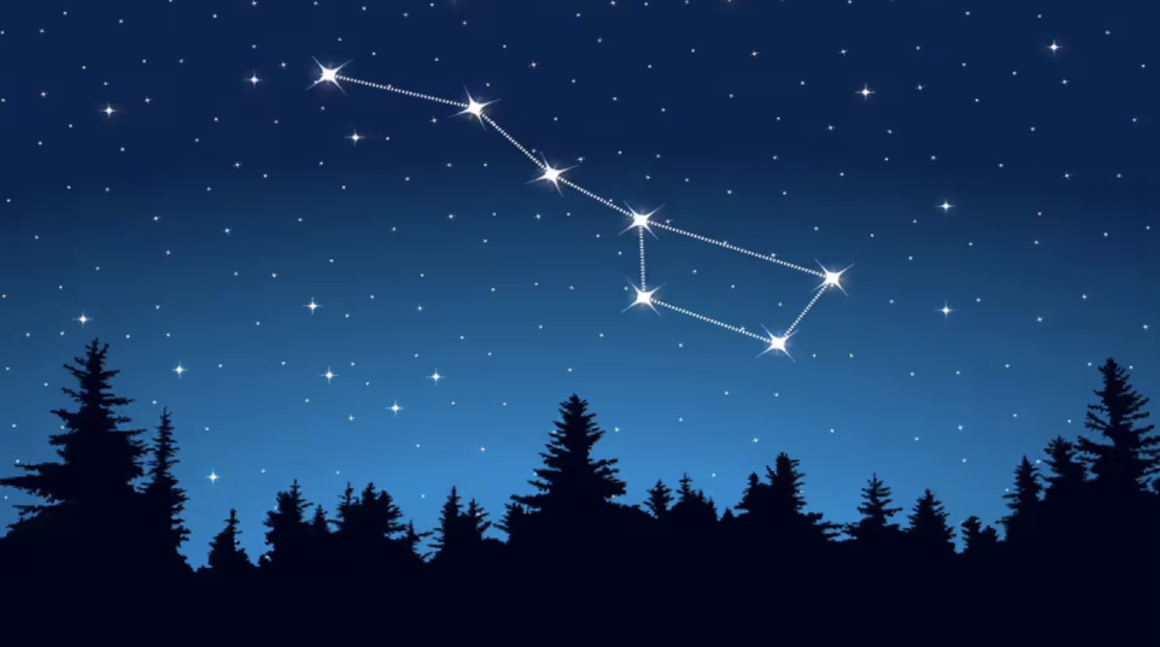
WARM UP QUIZ
LET’S FIND OUT WHAT WE ALREADY KNOW

Slide 2
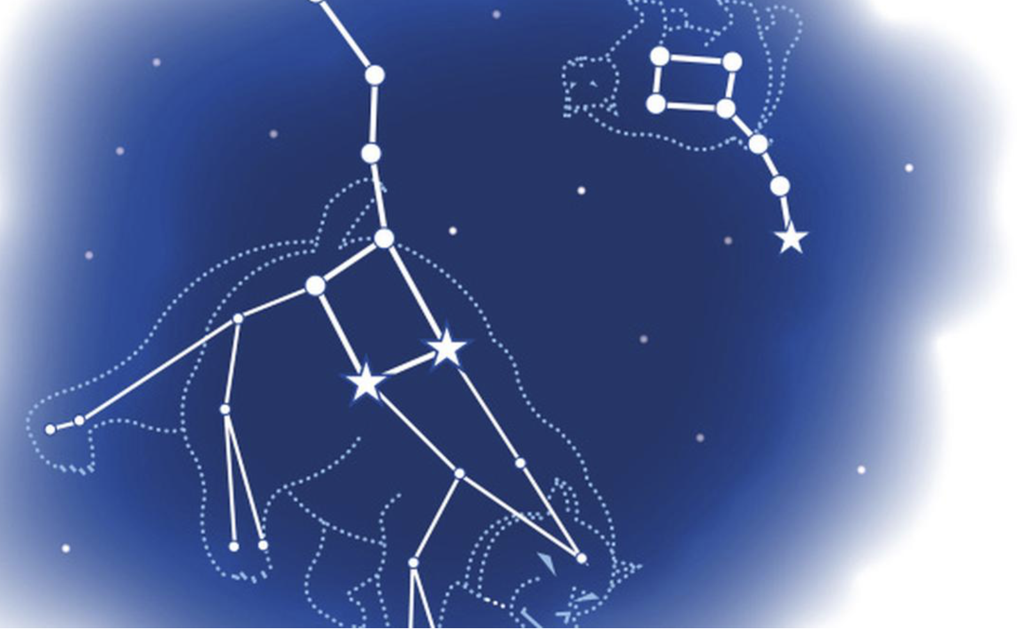

Slide 3
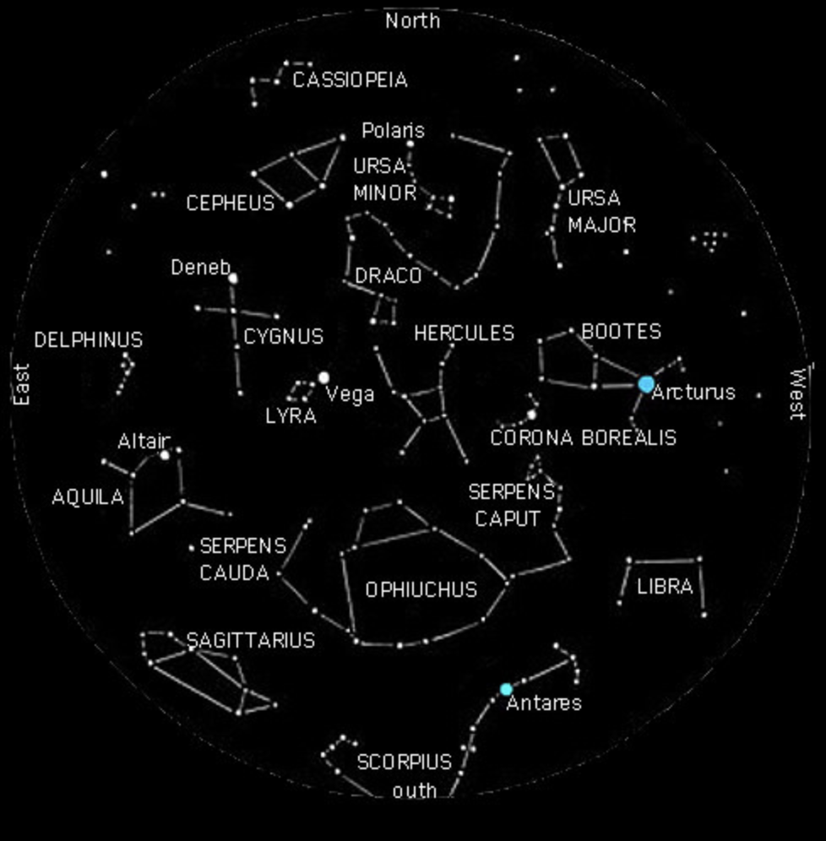

Slide 4
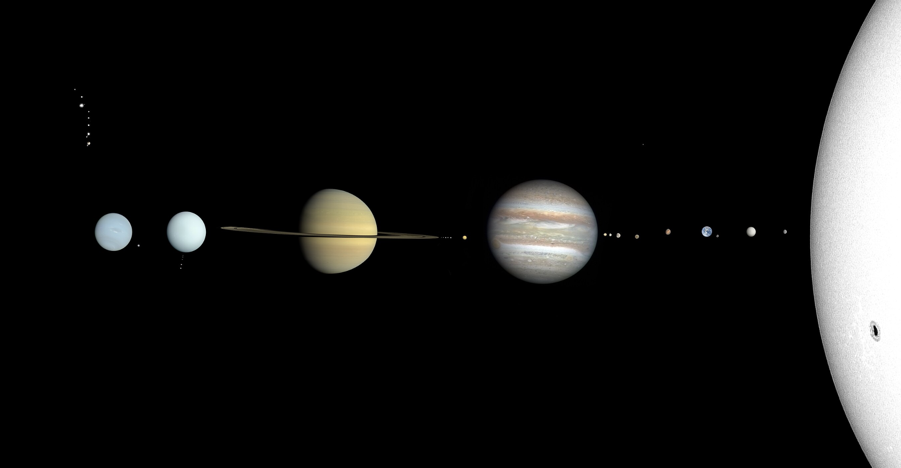
ROUND ONE : INTRODUCTION
1) What planet is closest to the sun?
2) Which is the hottest planet?
3) Why is Venus hotter than Mercury?
4) How far away is the sun?
5) How long does it take the sun’s light to reach Earth?

Slide 5
ROUND TWO : A LITTLE MORE CHALLENGING…
6) What star is closest to the Earth?
7) Name all of the planets in order, from closest to the sun to farthest away.
8) How many stars are in our galaxy?
9) What is the name of our galaxy?
10) Name Jupiter’s two largest moons.

Slide 6
ROUND THREE: Look up!
11) What is another name for the “North Star”?
12) Where is the North Star located?
13) Who were the first two people to walk on the moon?
14) What is the International Space Station?
15) What is the name of the large space telescope that orbits the Earth?

Slide 7
ROUND Four: To the stars
16) Name all of the planets that people have walked on
17) How long does it take Earth to orbit around the sun? days
18) How long does it take the Earth to rotate/spin all the way around?
19) What is a constellation?
20) How many stars are in the big dipper / the plough?

Slide 8
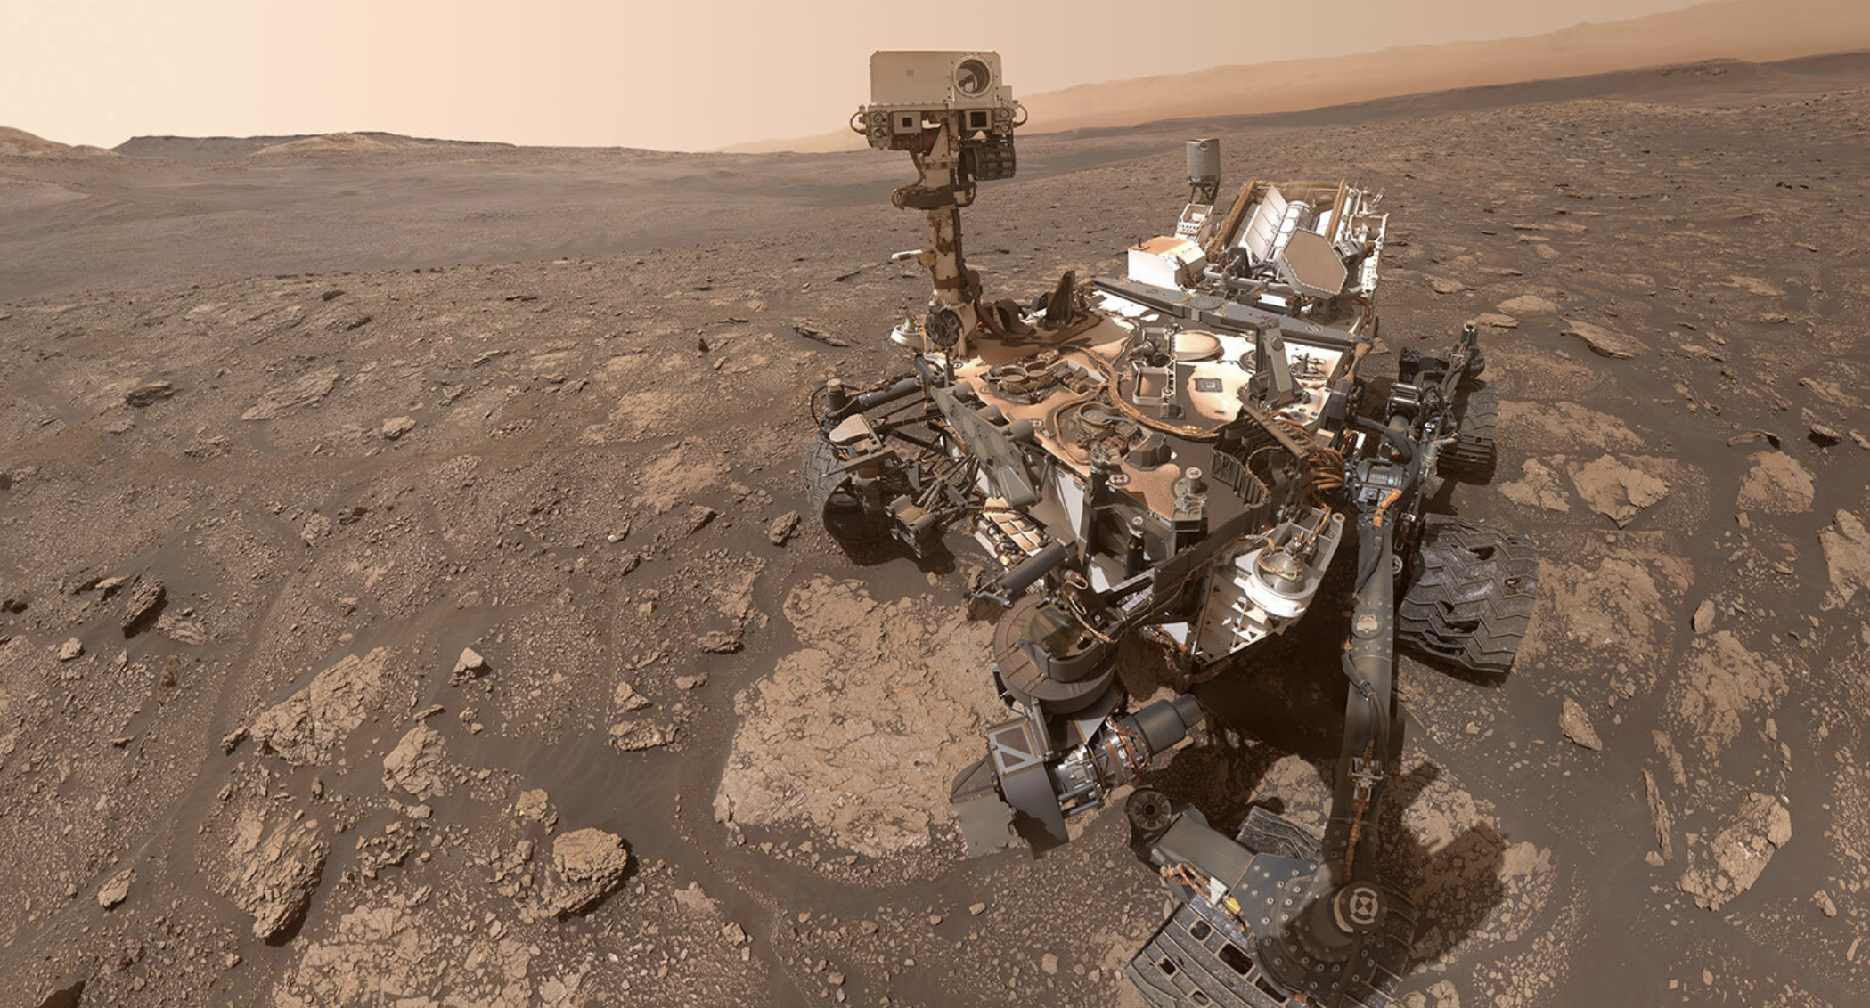
ROUND FIVE : How Curious…
ROUND FIVE : How Curious…
21) An American space explorer is an astronaut. What is a Russian space explorer?
22) How long does it take the moon to orbit the Earth?
23) Pluto is not a planet. What is it?
24) Which planet is nicknamed the “Red Planet”?
25) Which is the smallest planet?

Slide 9
BONUS QUESTION
What is the local group?

Slide 10
So, what was your score?
Did you reach the Milky Way or crash on the slopes of Olympus Mons?
(ouch!)

Slide 11
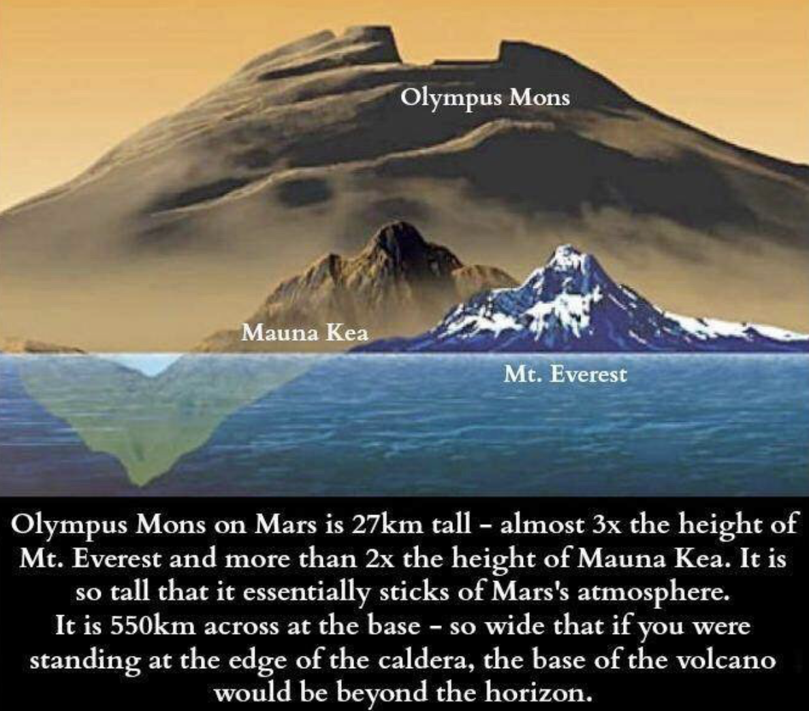

Slide 12
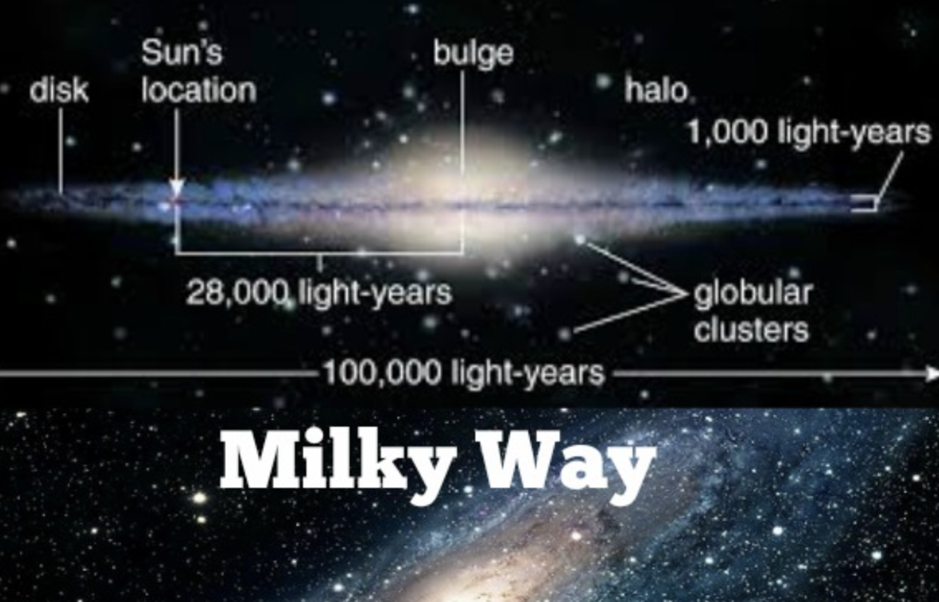

Slide 13
Question 1: What planet is closest to the sun? Answer: Mercury
Question 2: Which is the hottest planet? Answer: Venus
Question 3: Why is Venus hotter than Mercury? Answer: Clouds cover the planet and keep heat in.
Question 4: How far away is the sun? Answer: 93-million miles
Question 5: How long does it take the sun’s light to reach Earth? Answer: 8 minutes

Slide 14
Question 6: What star is closest to the Earth? Answer: the sun
Question 7: Name all of the planets in order, from closest to the sun to farthest away. Answer: Mercury, Venus, Earth, Mars, Jupiter, Saturn, Uranus, Neptune. And Pluto kinda.
Question 8: How many stars are in our galaxy? Answer: billions (Nobody knows exactly how many, but some scientists estimate about 100 billion.)
Question 9: What is the name of our galaxy? Answer: the Milky Way
Question 10: Name Jupiter’s two largest moons. Answer: Io and Europa

Slide 15
Question 11: What is another name for the “North Star”? Answer: Polaris
Question 12: Where is the North Star located? Answer: directly over the North Pole of the Earth
Question 13: Who were the first two people to walk on the moon? Answer: Neil Armstrong and Buzz Aldrin
Question 14: What is the International Space Station? Answer: A large satellite where astronauts/scientists can live and work.
Question 15: What is the name of the large space telescope that orbits the Earth? Answer: Hubble Space Telescope

Slide 16
Question 16: Name all of the planets that people have walked on. Answer: Earth (People have walked on the moon, but that's not a planet.)
Question 17: How long does it take Earth to orbit around the sun? Answer: 365 days
Question 18: How long does it take the Earth to rotate/spin all the way around? Answer: 24 hours
Question 19: What is a constellation? Answer: a group of stars that forms the shape of a person, animal, or object
Question 20: How many stars are in the big dipper? Answer: seven

Slide 17
Question 21: An American space explorer is an astronaut. What is a Russian space explorer? Answer: Cosmonaut
Question 22: How long does it take the moon to orbit the Earth? Answer: 29 days
Question 23: Pluto is not a planet. What is it? Answer: a dwarf planet (also accept: planetiod)
Question 24: Which planet is nicknamed the “Red Planet”? Answer: Mars
Question 25: Which is the smallest planet? Answer: Mercury

Slide 18
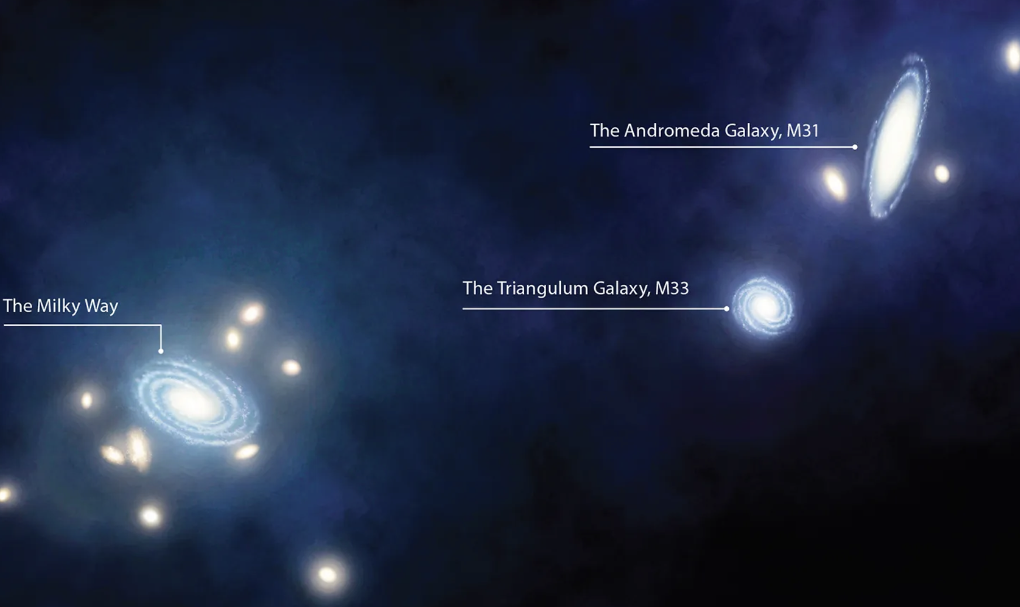
What is the Local Group?
Our universe contains at least hundreds of billions of galaxies, maybe trillions, in all shapes and sizes. Most are very far away from our home galaxy, the Milky Way.
Our Local Group of galaxies consists of our neighbouring galaxies within the vast universe.
The Local Group galaxies are all located within roughly 5 million light-years of space around us. The Local Group’s diameter is about 10 million light-years.

