Slide 1
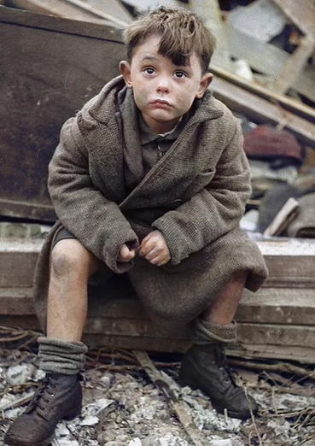
The Road to WW2

Slide 2
The Second World War
Arising from the expansionist and military ambitions of totalitarian regimes, WW2 began in 1937 in Asia (Japanese invasion of China) and 1939 in Europe (German invasion of Poland).
Following the entry of the USSR and USA into the war, it became global in scope.
The belligerents mobilized vast numbers of troops and committed extreme acts of violence against civilians, notably through the Nazi policies of genocide, creating an unprecedented war of extermination.

Slide 3
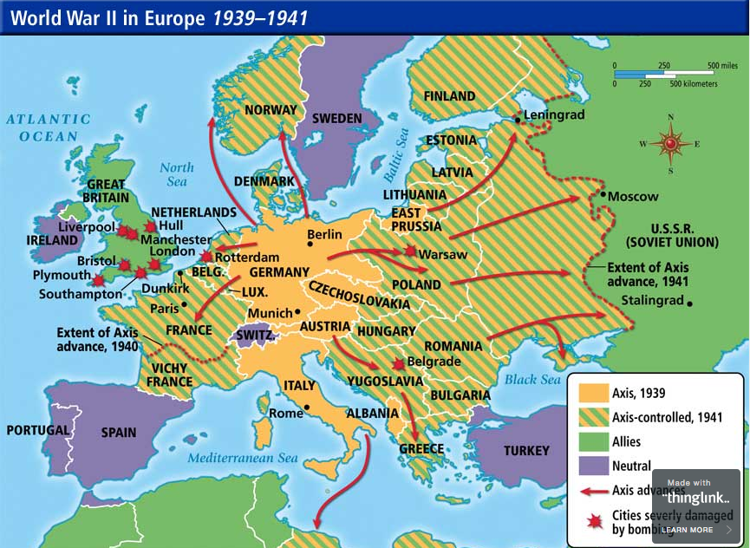

Slide 4
Great Britain and WW2 Appeasement and Neville Chamberlain (1869-1940) UK PM 1937-40
Appeasement was the name given to Britain’s policy in the 1930s of allowing Hitler to expand German territory unchecked.
It is most closely associated with British Prime Minister Neville Chamberlain, it is now widely discredited as a policy of weakness.
Yet at the time, it was a popular and seemingly pragmatic policy.

Slide 5
Appeasement
In March 1938, Hilter annexed Austria.
At the Munich Conference that September, Neville Chamberlain seemed to have averted war by agreeing that Germany could occupy the Sudetenland, the German-speaking part of Czechoslovakia - this became known as the Munich Agreement.
In Britain, the Munich Agreement was greeted with jubilation. However, Winston Churchill, then estranged from government and one of the few to oppose appeasement of Hitler, described it as ‘an unmitigated disaster’.
But, despite his promise of ‘no more territorial demands in Europe’, Hitler was undeterred by appeasement. In March 1939, he violated the Munich Agreement by occupying the rest of Czechoslovakia.
Six months later, in September 1939, Germany invaded Poland and Britain was at war.

Slide 6
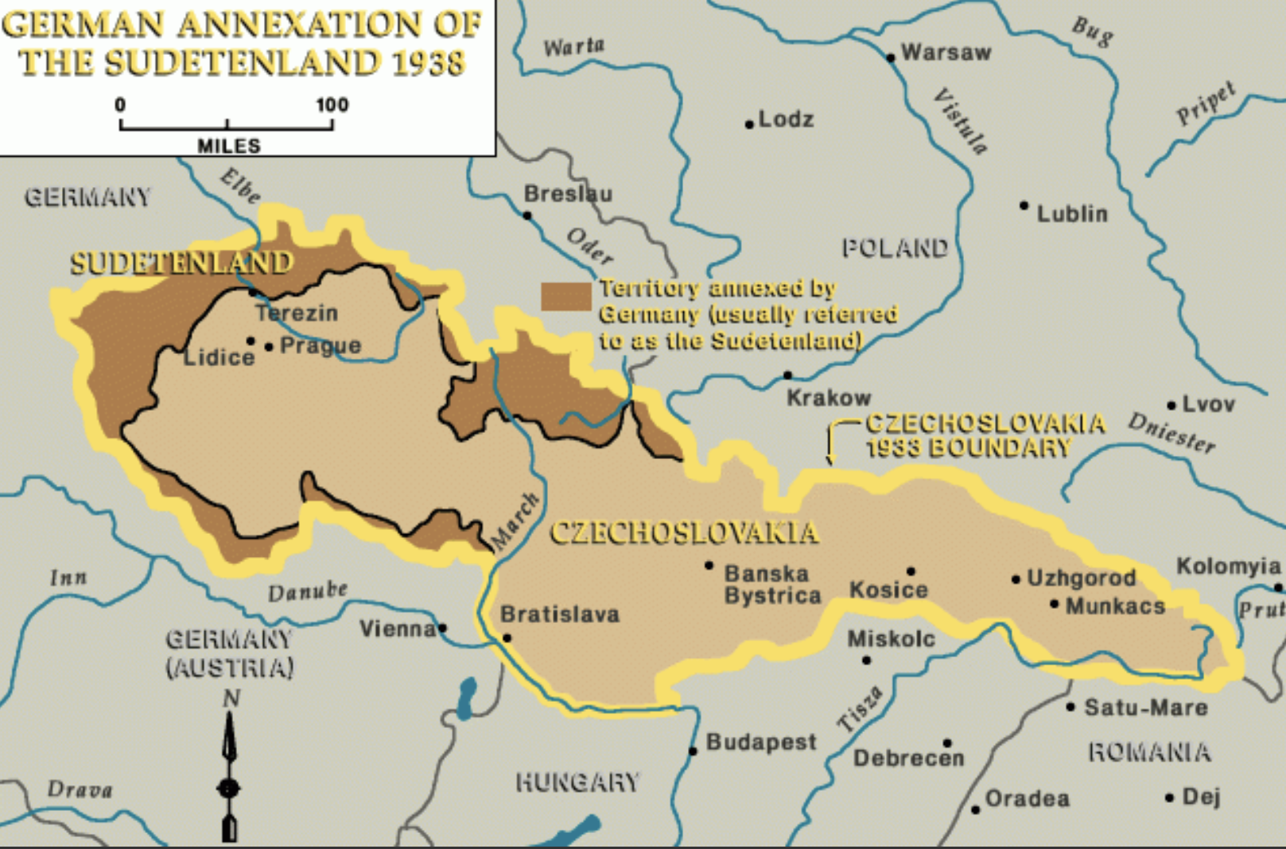
German Annexation of the Sudentenland, 1938

