Slide 1
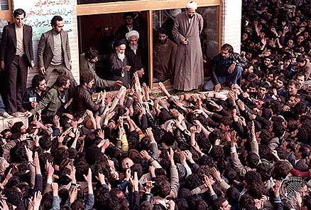
Oil and Political Islam: Regional and Global Challenges 1973-1991
Ruhollah Khomeini (centre) greeting supporters after returning to Tehrān, February 1979.

Slide 2

Part One: the ‘73 Shock

Slide 3
Overview of the Oil Price Shocks
In 1973 the Yom Kippur War led to a global economic crisis and the return of mass unemployment in the industrialised countries for the first time since the 1930s, due to an OPEC imposed oil embargo.
This also marked the end of the so-called ‘Trente Glorieuses’ of economic growth from 1945 to 1975 (as it was later described by French economist Jean Fourstié in 1979).
The situation was further compounded in 1979 by the Iranian Revolution. Although this only led to a 4% drop in world oil production, the oil market’s reaction doubled the price of crude oil to $39.50 per barrel by 1980.

Slide 4
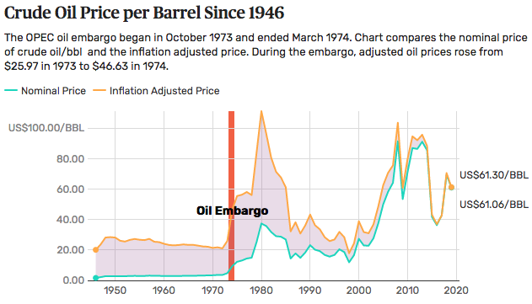
Impact of the 1973 and 1979 oil price shocks

Slide 5
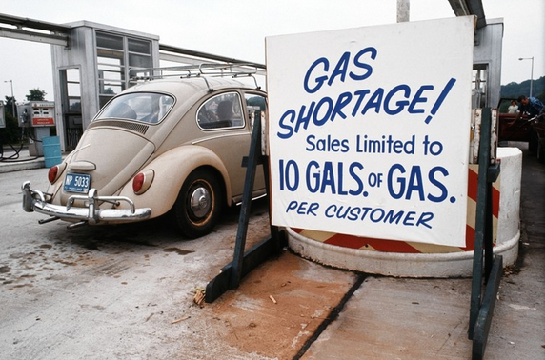
A Connecticut filling station in 1974 amid the oil embargo

Slide 6
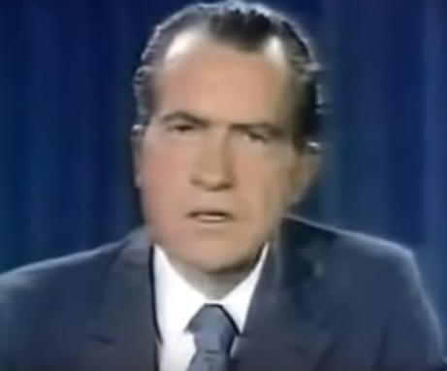
Prelude to the 1973 Oil Price Shock:
The Nixon Shock
The conditions for the ’73 embargo were created by President Nixon’s decision in 1971 to take the United States off the Gold Standard.
This meant countries could no longer redeem US dollars held in their foreign exchange reserves for gold. (In taking this decision, Nixon also went against the Bretton Woods Agreement).
There were two notable consequences: firstly the price of gold shot up and secondly the value of the dollar fell. This double whammy hurt the OPEC countries.

Slide 7
The OPEC Response
The plummeting value of the dollar hurt OPEC countries because all oil contracts were priced in US dollars.
This meant their revenues fell with the dollar.
On October 19, 1973, Nixon requested $2.2 billion from Congress in emergency military aid for Israel (fighting the Yom Kippur War).
The Arab members of OPEC responded by halting oil exports to the United States and other Israeli allies.
Egypt, Syria, and Israel declared a truce on October 25, 1973. OPEC continued the embargo until March 1974. By then, oil prices had skyrocketed from $2.90/barrel to $11.65/barrel

Slide 8
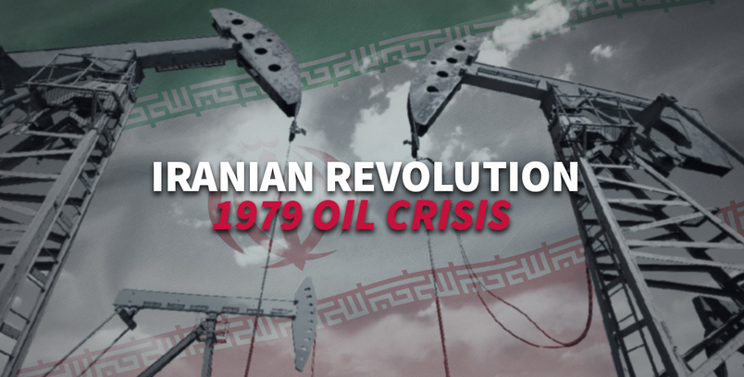
Part Two: the ‘79 Shock

Slide 9
The Iranian revolution was a series of events that ended the secular totalitarian regime of the Shah, also known as the ‘ancien regime’ and replaced the Shah with Ayatollah Khomeini.
What really caused the Iranian revolution is still a matter of debate. Some claim that it was related to resisting a forceful westernization, modernization and secularization of Iran while others cite a reaction of the people against the social injustice of the regime and its other failures.

Slide 10
Collapse of the Persian Monarchy
By 1979 the regime of the Shah, Mohammad Reza Shah (1919-1980) was under pressure from religious and popular revolt (there had been a general strike in October 1978).
Ayatollah Khomeini (1902-1989) who had been in exile since the late 1960s organized the fight against the Shah’s regime which collapsed in February 1979.
On 11th February 1979 the Ayatollah declared the Islamic Republic founded on the strict application of Islamic law.

Slide 11
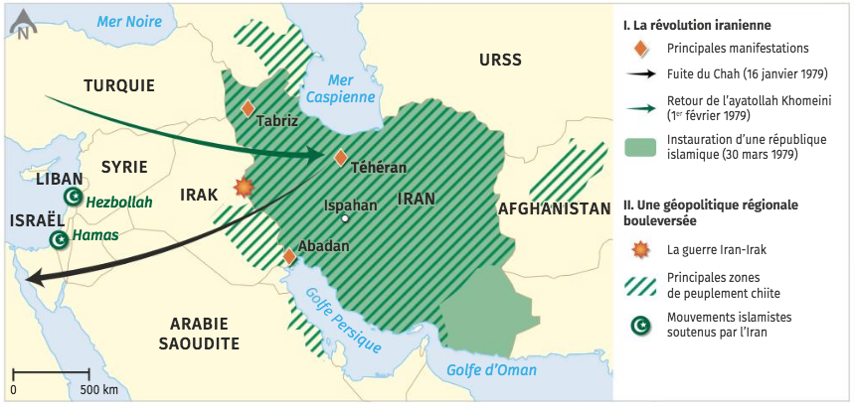
Iran and regional influence
Translation: Chitte = Shitte Muslims (see slide 14 or Britannica for more details).
Note the proximity of the border to the USSR and think about how the Soviet Union viewed this revolution… (link to Part Three of this Power Point).

Slide 12
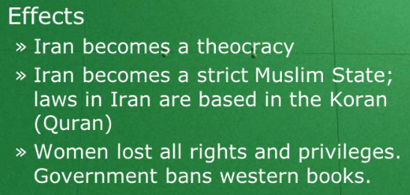
Impact of the Revolution
The Iranian Revolution provoked a second oil shock which changed the course of geopolitics, global power balance and shook the oil markets much like the first oil shock of 1973.
Internal impacts of the Iranian Revolution

Slide 13
Regional impact of the Revolution
Khomeini proclaimed that the governments of other Muslim counties in the Middle East were corrupt and un-Muslim and had to be overthrown (especially those governments with ties to the West or the USSR).
Whilst millions of Arab Muslims welcomed the revolution, especially when Iranians defied the USA by taking 52 Americans hostage at the US Embassy in November 1979, most Arab states were suspicious of Iran.

Slide 14
This mistrust arose from historical reasons because Iran was Persian not Arab, and religious reasons.
Most people of Iran were Shiite Muslims whereas the majority of Arab Muslims were Sunnis.
When the Iran-Iraq war broke out in 1980; most Arab, Muslim states supported secular, Sunni-dominated, Arab Iraq. They did not want to support radical Islamic Politics.

Slide 15
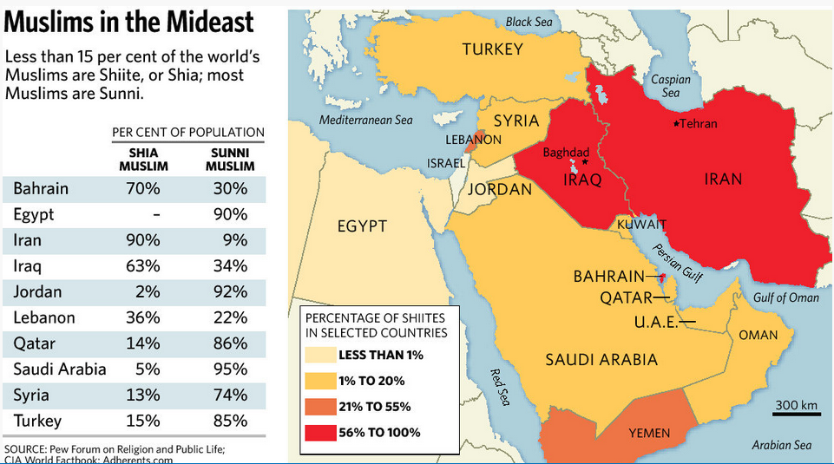

Slide 16
The Second Oil Shock
The Iranian revolution resulted in a disruption in Iranian oil imports.
Although Saudi Arabia and other OPEC nations increased production to offset this decline, raising oil prices, the near nuclear disaster at Three Mile Island on March 28 increased energy anxieties throughout the United States.
Auto companies were unprepared for the sudden rise in fuel prices. As the price of oil rose from $15.85 to $39.50 over the next 12 months, motorists began panic-buying gasoline.
High oil prices caused industrial nations to take steps to reduce dependence on OPEC oil. Non-OPEC production dramatically increased, notably in the U.S.S.R, Venezuela, Nigeria and Alaska and the North Sea.

Slide 17
Reduced influence of OPEC
By 1986, daily worldwide demand for oil dropped by 5 million barrels.
OPEC's market share was reduced from 50% in 1979 to 29% in 1985. The resulting increase in fuel economy led to an oil glut in the 1980s. Although demand for OPEC oil eventually would rise to pre-1979 levels, the western world’s dependence on OPEC oil would never be the same.

Slide 18
Political and economic repercussions
The destabilization experienced by industrialised countries led to a new level of international cooperation.
In November 1976, at the initiative of Valéry Giscard d’Estaing, the six richest countries of the world (USA, France, Italy, Japan, UK and FRG) formed the Group of Six (G6) which became the G7 in 1976 with the addition of Canada.
The purpose of the G7 was/is for major world leaders to meet annually and discuss global economic questions.

Slide 19
From 1979, neoliberalism and deregulation were pursued as policy options in order to confront the crisis.
This policies were most prominently deployed by Margaret Thatcher in the UK (PM 1979-90) and Ronald Regan in the USA (President 1981-89).
Japan, FRG and France (under President Mitterrand) also implemented privatisation programmes in response.
These policies had varying degrees of success and were criticised for their social consequences (such as increase unemployment and reduced welfare expenditure).

Slide 20
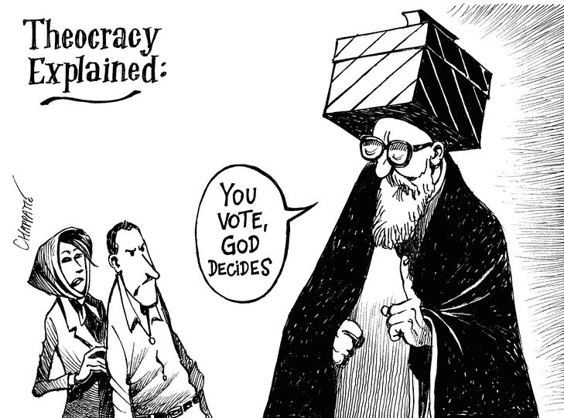
Part Three: Rise of Radical Islam

Slide 21
Overview
From the late 1960s, Arab nationalism lost its appeal and Islamic fundamentalism became a growing force in the Middle East. Al-Qaida emerged and later grew into a worldwide network of Islamic radicals.
It achieved international notoriety in 2001 with its attacks on New York and Washington D.C.

Slide 22
Why did Arab Nationalism lose its appeal?
The death of Nasser, in 1970, in some ways symbolised the decline of Arab nationalism since he was seen as the voice of this movement.
However, Israel’s victory and humiliation of Egypt, Syria and Jordan in the Six Day War of 1967, meant that Arab nationalism had already lost its appeal since it was seen to have failed.

Slide 23
What is political Islam?
The vacuum left by Arab nationalism was filled by Islamic fundamentalism a.k.a. political Islam.
This was based on the belief that States should be based on laws derived from the Koran. Followers are known as fundamentalists because they believe the state should be fundamentally based on Islamic law.

Slide 24
The Second Cold War
In 1978 Afghan communists, supported by the USSR seized control of the government of their country. They immediately faced rebellion from a number of Islamist groups who resented communist influence.
In December 1979 the Soviet Union sent in troops to assist the government. This led to a huge rebellion over the next 10 years as Afghan guerrillas, known as the mujahideen, fought the Soviet troops and were supported by other Muslim countries such as Pakistan and Saudi Arabia + the USA and UK who wanted to defeat the USSR.

Slide 25
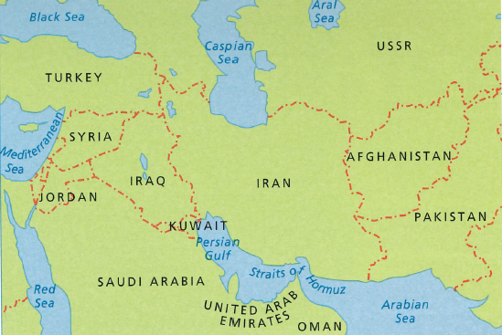
The Middle East in 1979

Slide 26
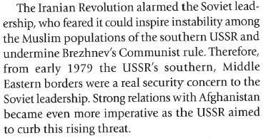
Rationale for the Soviet Invasion

Slide 27
Emergence of al-Qaida
The USA provided weaponry (e.g. Stinger missiles to shoot down Soviet helicopter gunships), Saudi Arabia encouraged volunteers to go and fight in Afghanistan, and the US, UK & Pakistani intelligence services trained and armed these recruits to fight against the Soviets.

Slide 28
One of the Saudi volunteers was Osama Bin Laden (son of a large construction business owner in Saudi Arabia) who organized the activities of thousands of Arab Islamists fighting alongside the mujahideen.
He also established training camps or bases, the Arabic word for which is al-Qaida.
These ‘Arab Afghans’ became very experienced guerrilla fighters.
In 1989 the Soviet Union withdrew. Many Islamist groups felt if they could defeat the USSR then they could also defeat weaker, unpopular Arab regimes (e.g. repeated terrorist attacks on police and government officials in Egypt throughout the 1990s).

Slide 29
Iraq War 1990-91
The US-led attack on Iraq following the invasion of Kuwait by Saddam Hussein in 1990-91 shattered the alliance with the ‘Arab Afghan’ fighters.
The Saudi government invited US troops into Saudi Arabia. The Arab Afghans were horrified to see the forces of unbelievers occupying Islamic soil.
In the eyes of Osama Bin Laden the Saudi authorities had forfeited their claim to protect Islam.
In 1992 he left Saudi Arabia for the Sudan and two years later he became stateless when the Saudi government deprived him of his Saudi nationality.

Slide 30
