Slide 1
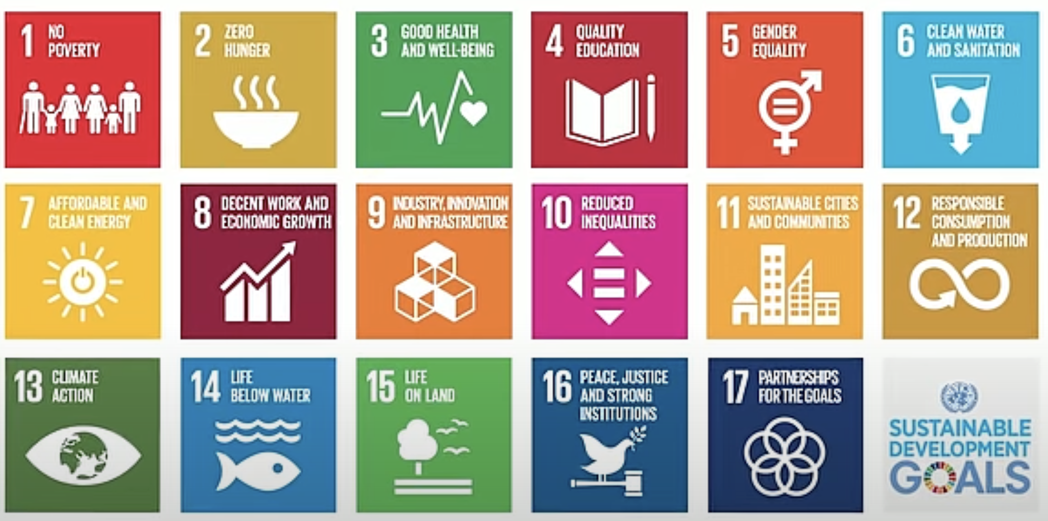
UN Sustainable Development Goals

Slide 2
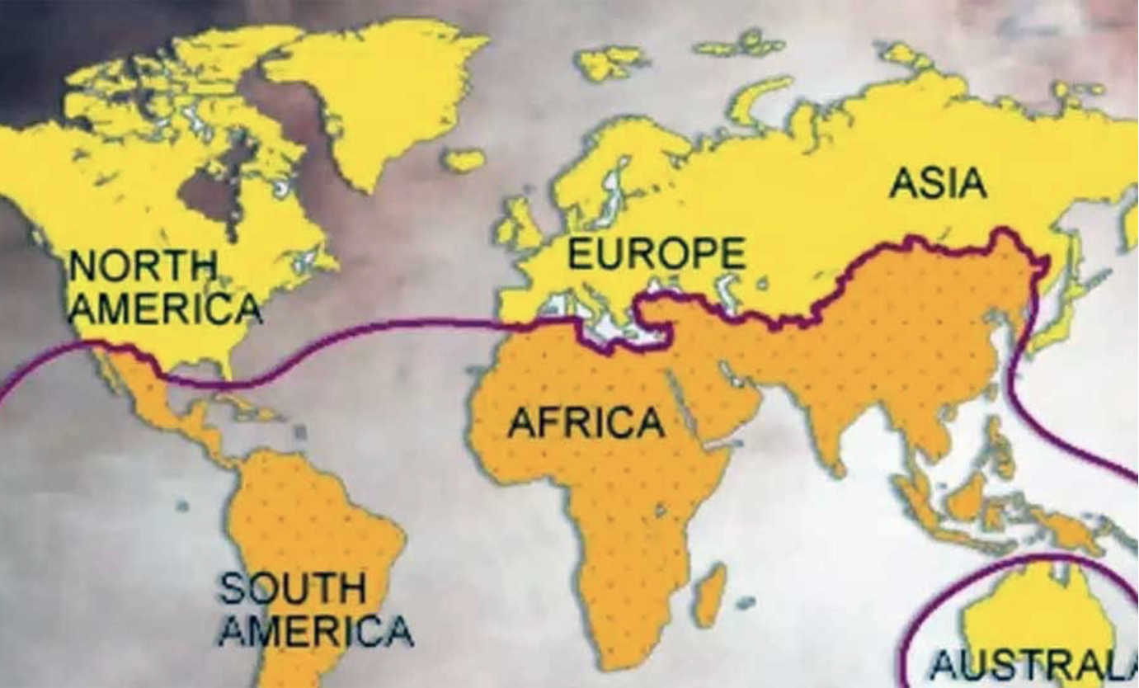

Slide 3
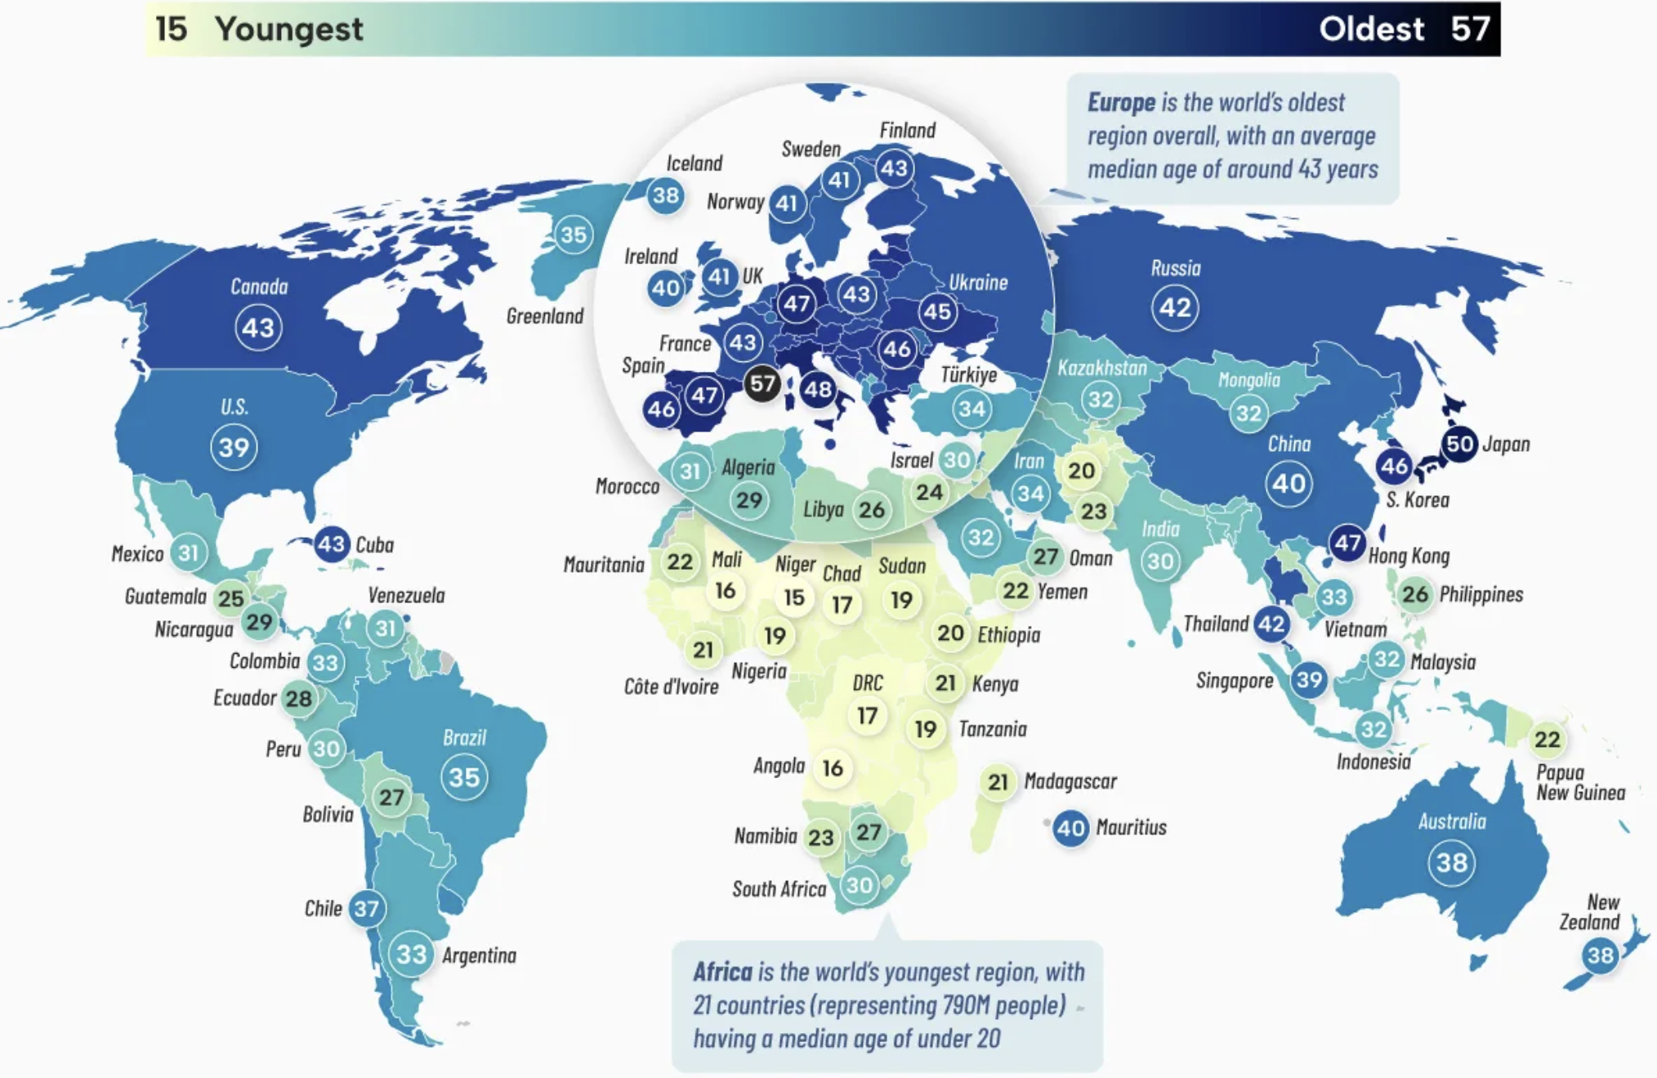
Global Median Ages

Slide 4
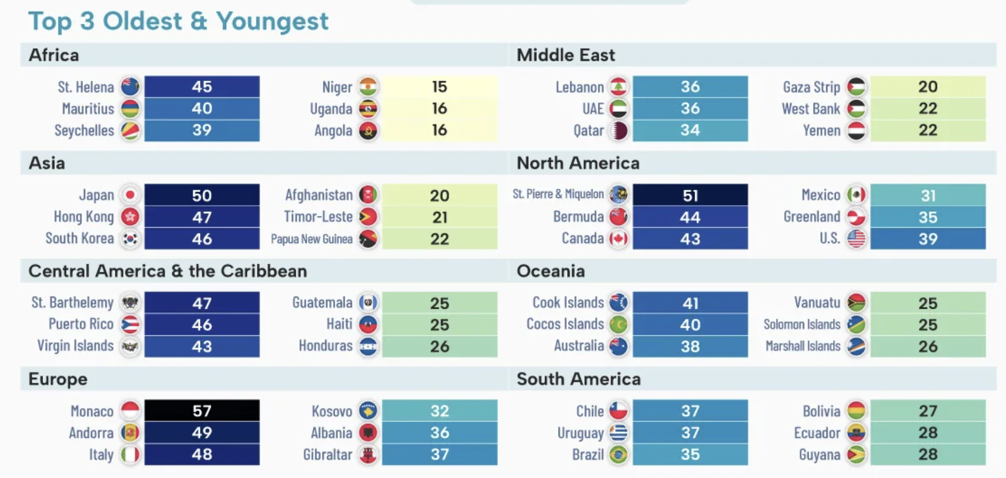

Slide 5
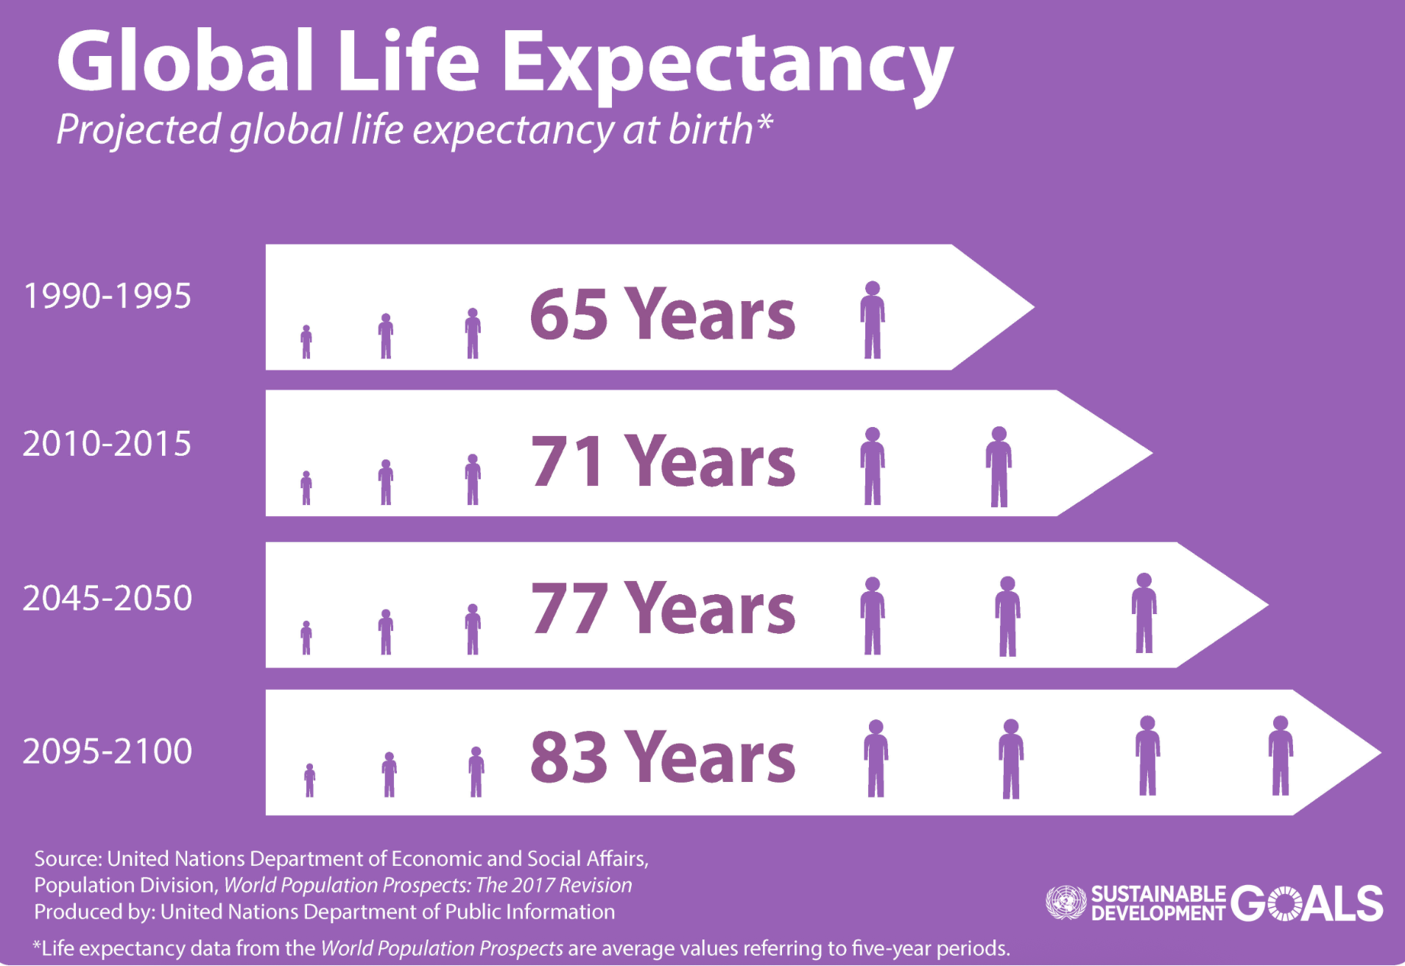

Slide 6
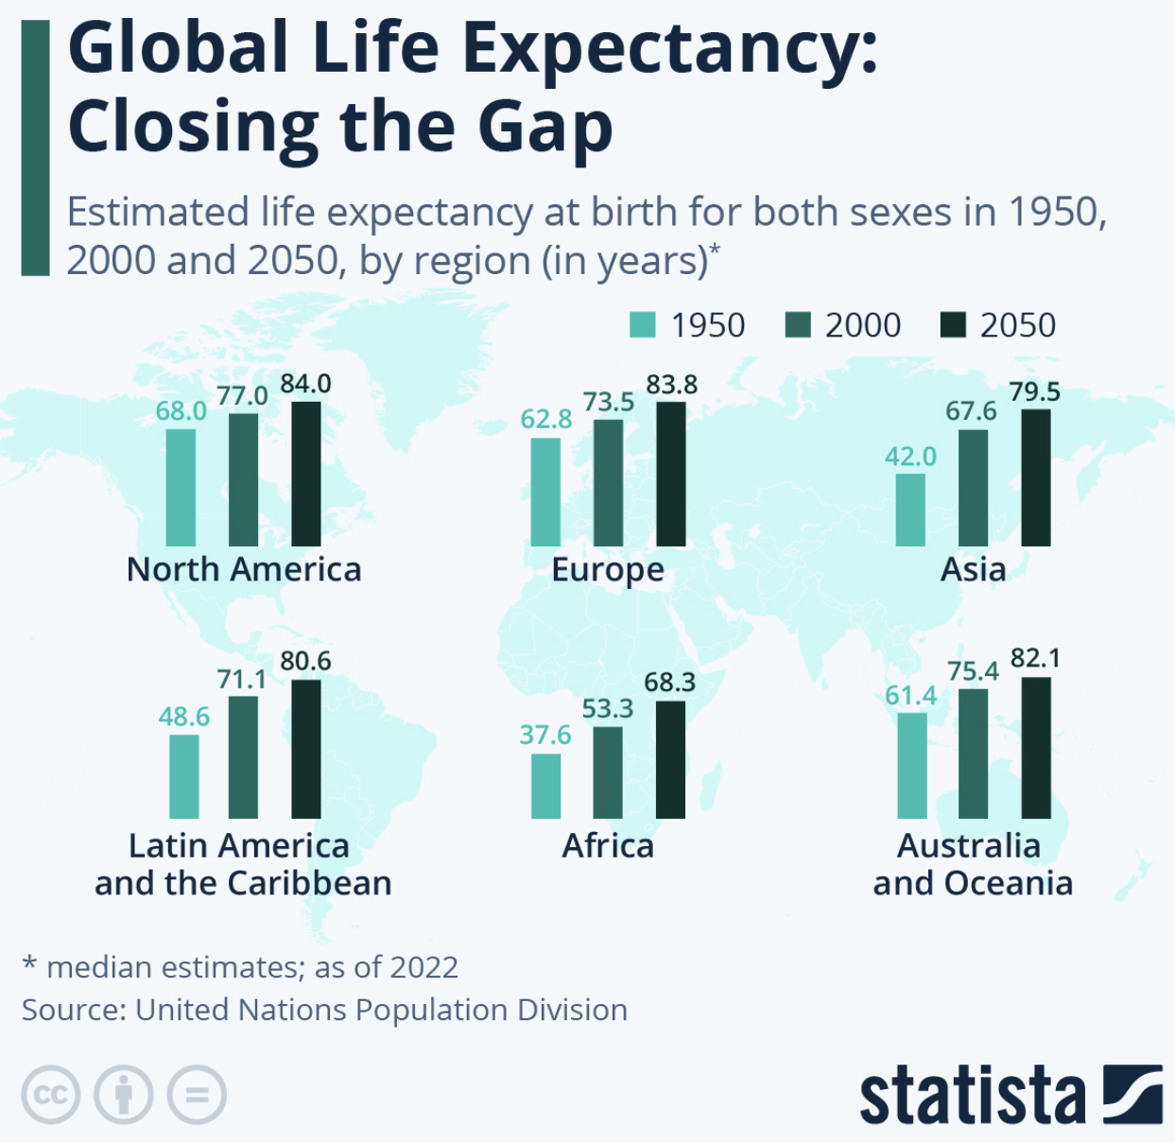

Slide 7
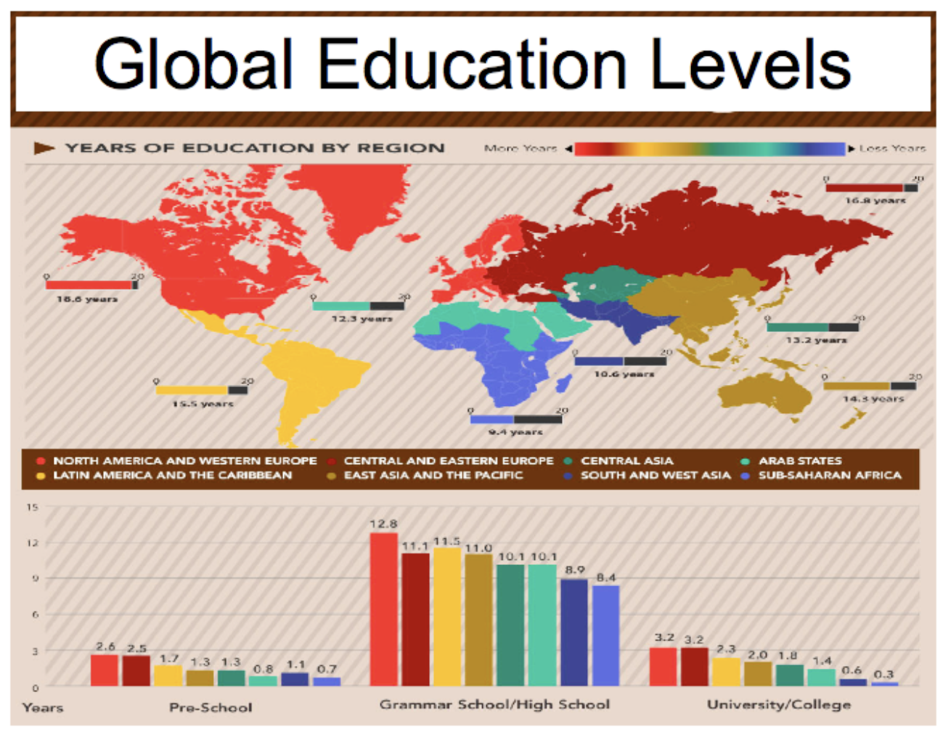
This combined image shows the number of years children and young adults attend school.
Sub-Saharan Africa, South Asia and the Middle East, and North Africa are the three most education-deficient regions as shown on the map.
Source: UNESCO

Slide 8
Main economic sectors
1. Primary sector: Businesses that produce or collect natural resources (agriculture, mining, quarrying, forestry, oil and gas industries).
2. Secondary sector: Businesses that process raw materials into finished products. All processing, construction, and manufacturing jobs fall into this sector, including aerospace manufacturing, automobile production, textile production, shipbuilding, chemical, and engineering industries.
3. Tertiary sector: or service sector, comprises service providers: retail sales, transportation, insurance companies, restaurants, tourism, entertainment, legal services, health care…
4. Quaternary sector: Businesses related to intellectual activities, such as education, government decision-making, information technology, research and development.

Slide 9
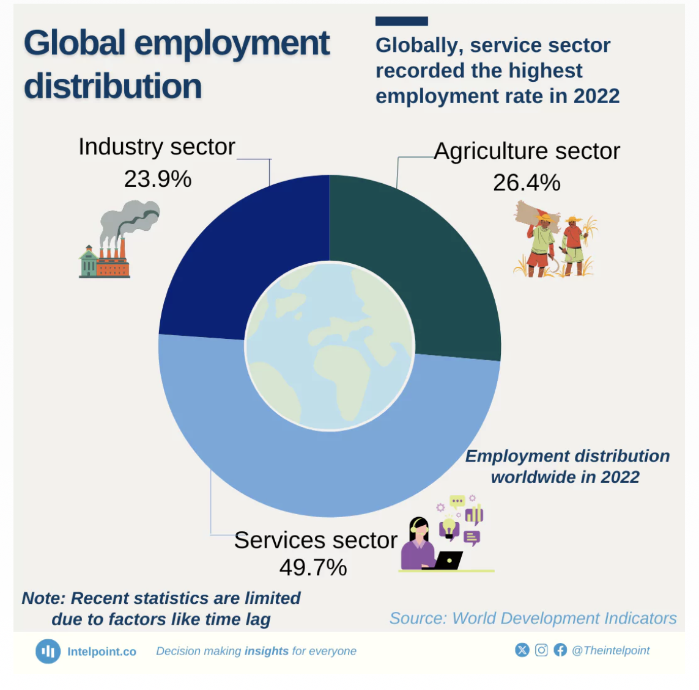

Slide 10
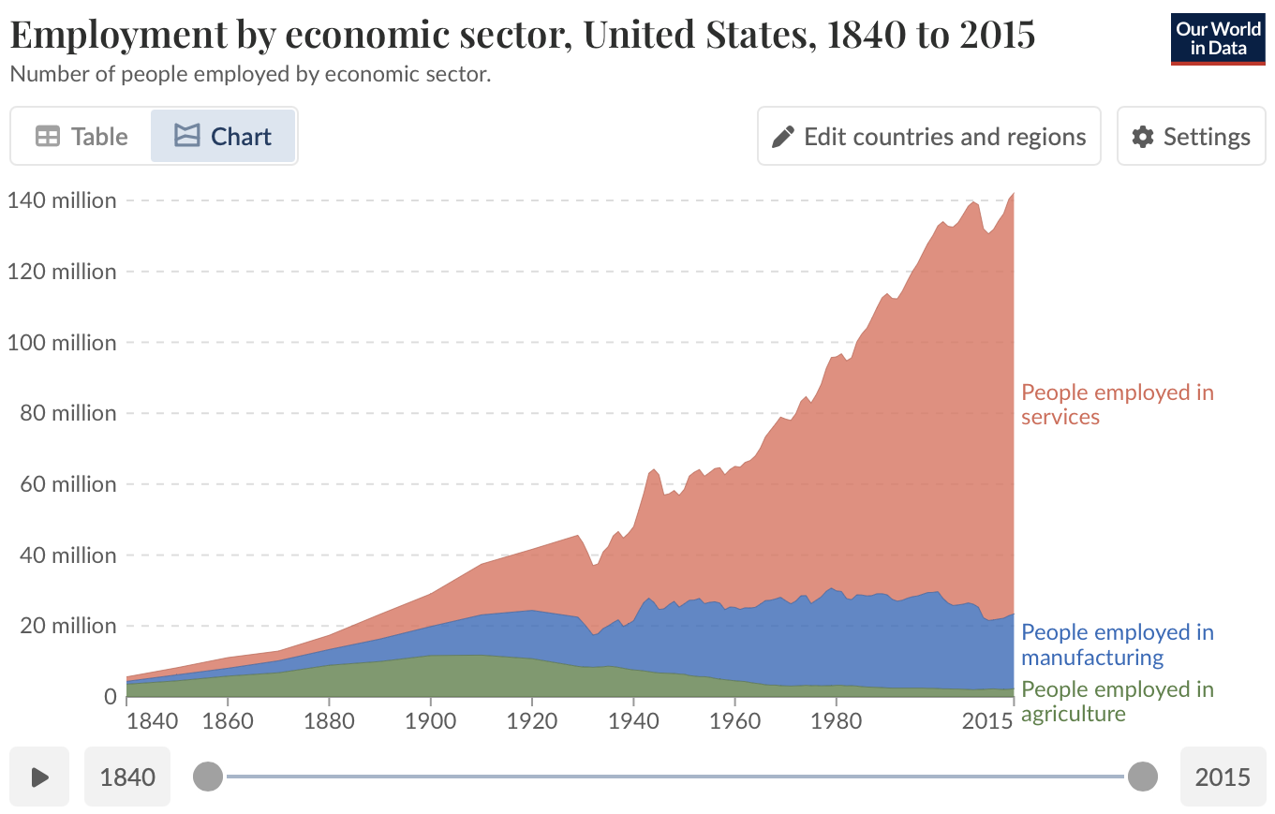

Slide 11
