Slide 1
The Multi-Polar World

Slide 2
Defining a multi-power world
A multi-polar world refers to one which is dominated by at least three States. During the Cold War the world was viewed as being divided between two powers – the Communist USSR and Capitalist USA.
With the continued dominance of the USA coupled with the rise of China and the European Union plus the development of the BRICS, a multi-polar world is becoming a reality.

Slide 3
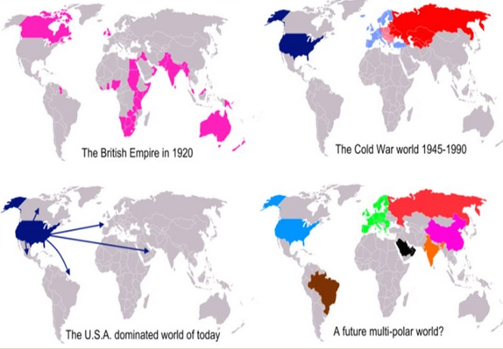
Uni-polar, Bi-polar, Multi-polar Worlds

Slide 4
How is power measured?
A State’s power is measured in terms of its ability to exert influence on a global scale.
This could be economic, industrial, political, cultural, financial, diplomatic and military in scope.
Power can be maintained and enhanced through soft power (spread of culture and influence) or hard power (military presence).

Slide 5
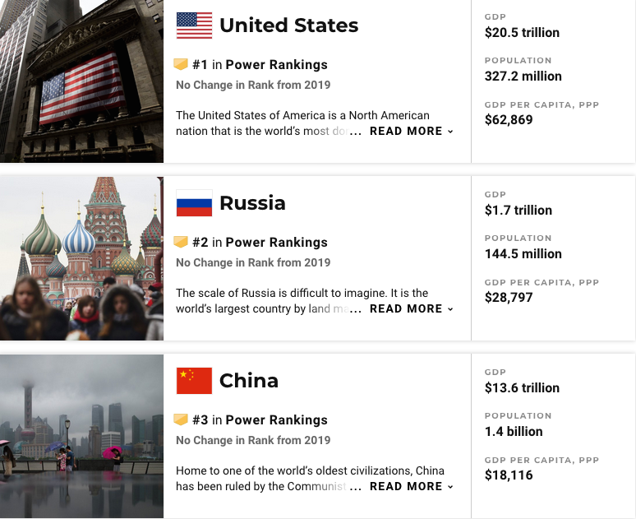
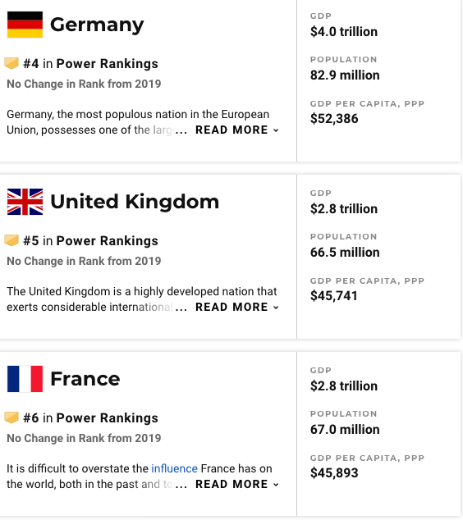
2020 World Power Rankings

Slide 6
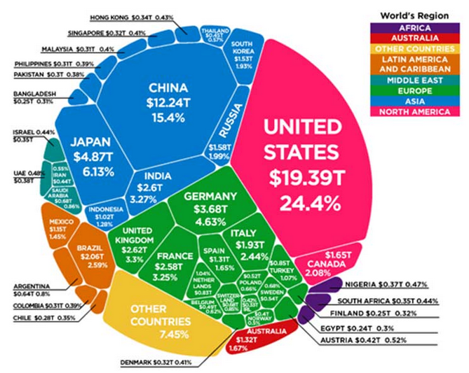
Global Economy 2018

Slide 7
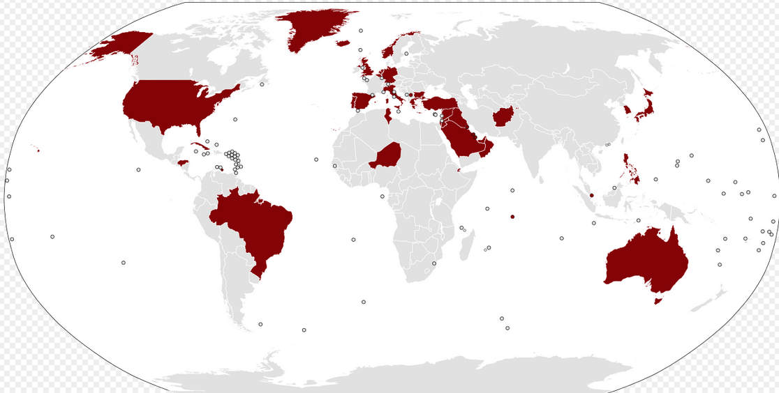
Countries hosting US military bases: evidence of continuing US dominance

Slide 8
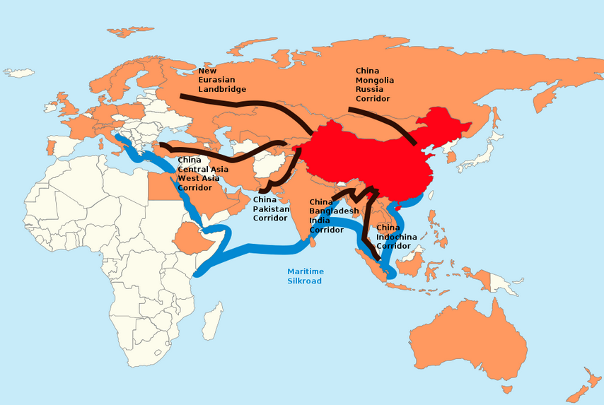
China’s Belt and Road: evidence of an increasingly multi-polar world
China in Red, the members of the Asian Infrastructure Investment Bank in orange. The proposed corridors in black (Land Silk Road), and blue (Maritime Silk Road).

