Slide 1
Effects and Implications of Climate Change on the Arctic

Slide 2
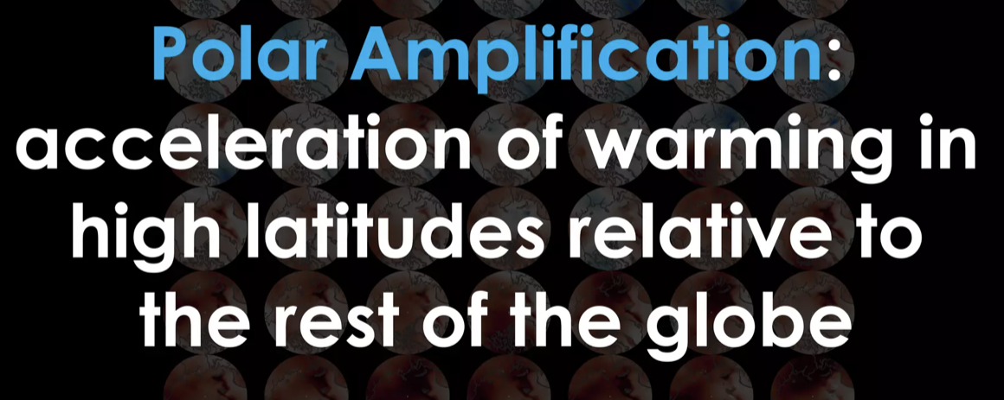
DNL Vocabulary

Slide 3
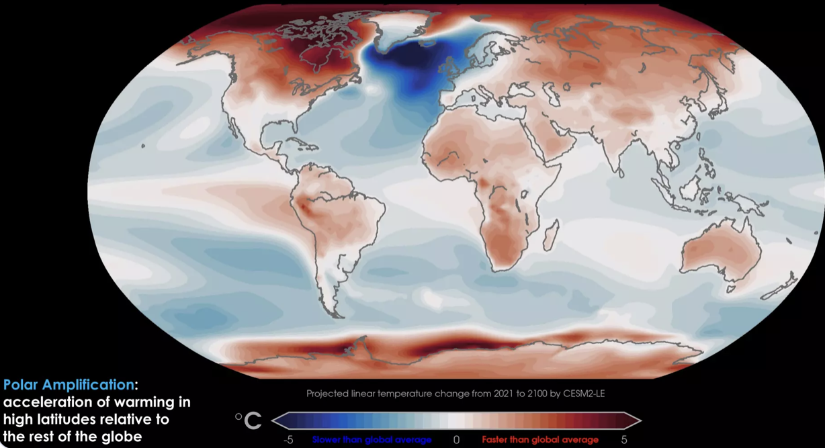
Temperature change relative to rest of world

Slide 4
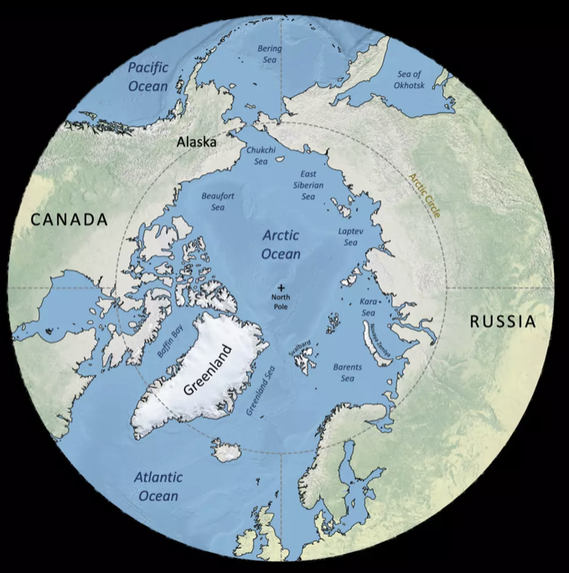
Arctic Circle starts at 66.5 degrees of latitude north

Slide 5
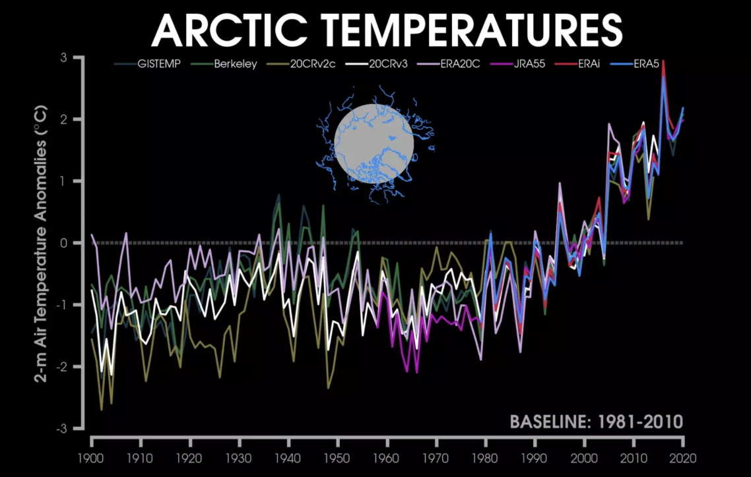
Arctic temperatures are rising

Slide 6
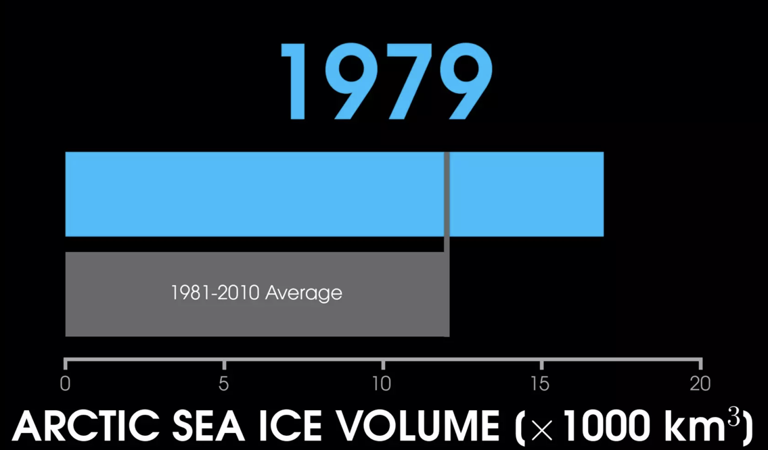
Sea ice volume is decreasing

Slide 7
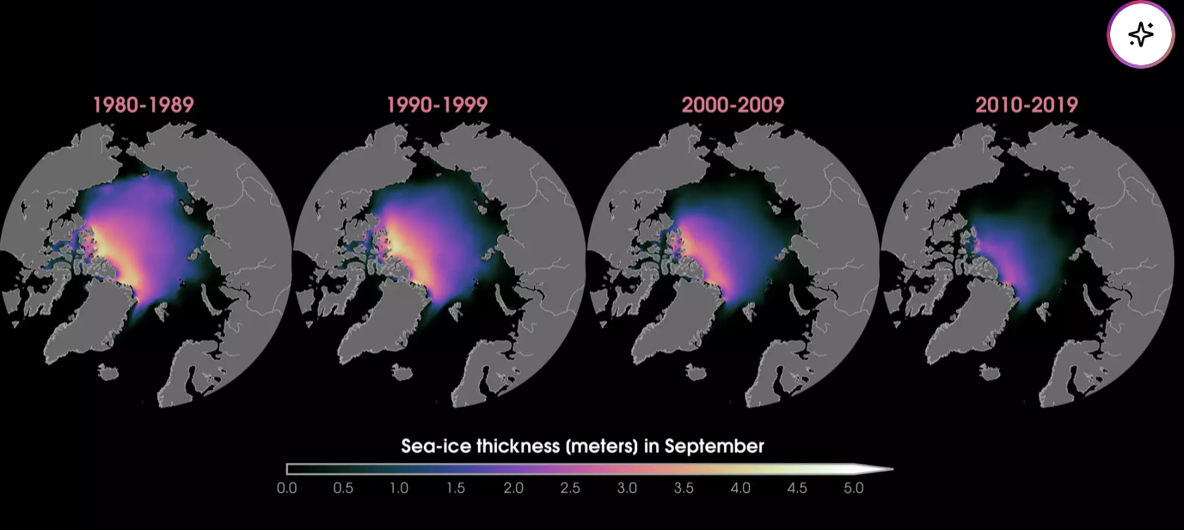
Thickness of Arctic ice is decreasing

Slide 8
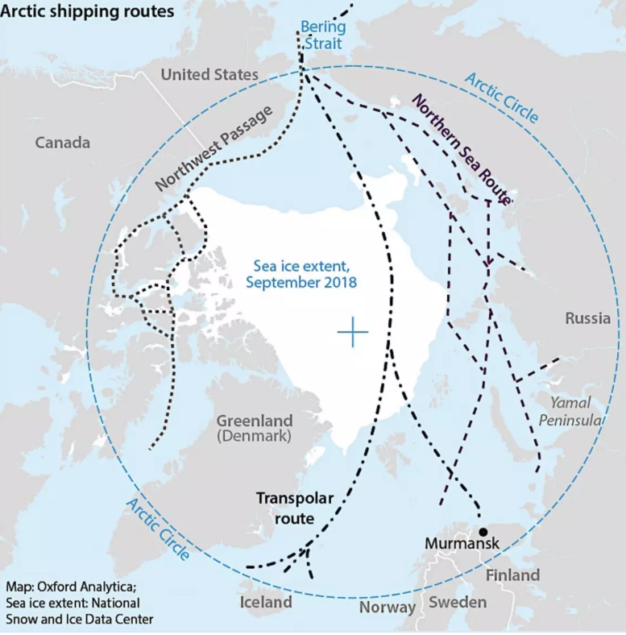
Economic implications of melting ice

