Slide 1
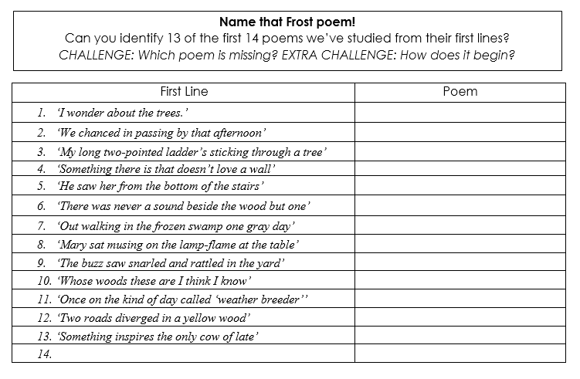
Do Now: Demonstrate your knowledge of the poems we’ve studied so far.

Slide 2
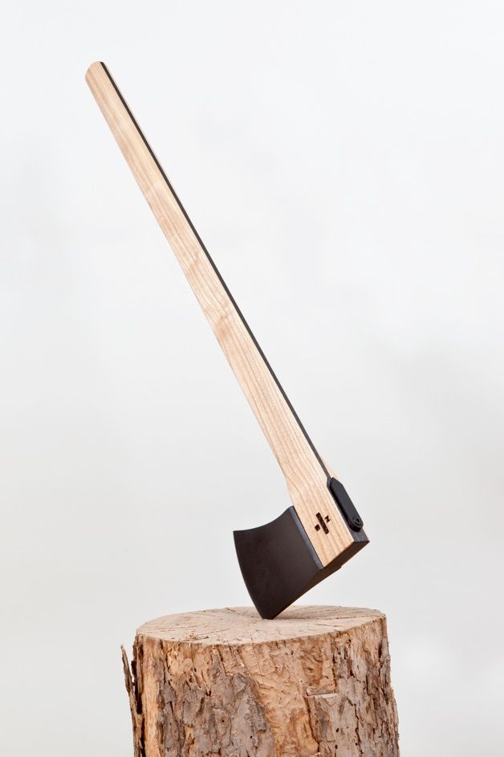
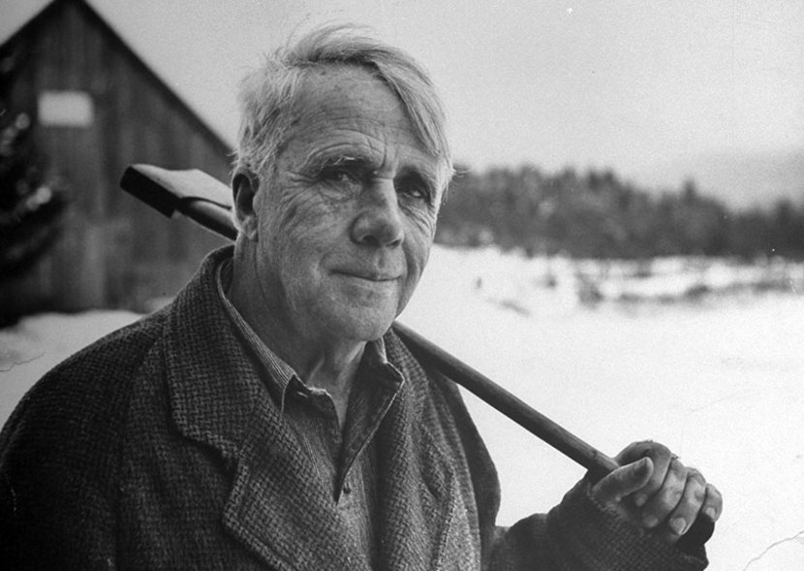
‘You know the Canadian woodchoppers whittle their ax-handles, following the curve of the grain, and they’re strong and beautiful. Art should follow lines in nature, like the grain of an ax-handle. False art puts curves on things that haven’t any curves’
Discuss with your table:
What is Frost trying to communicate about art through this simile?
What tone do you detect in Frost’s quote – how would you describe Frost’s attitude towards Canadian woodchoppers?

Slide 3
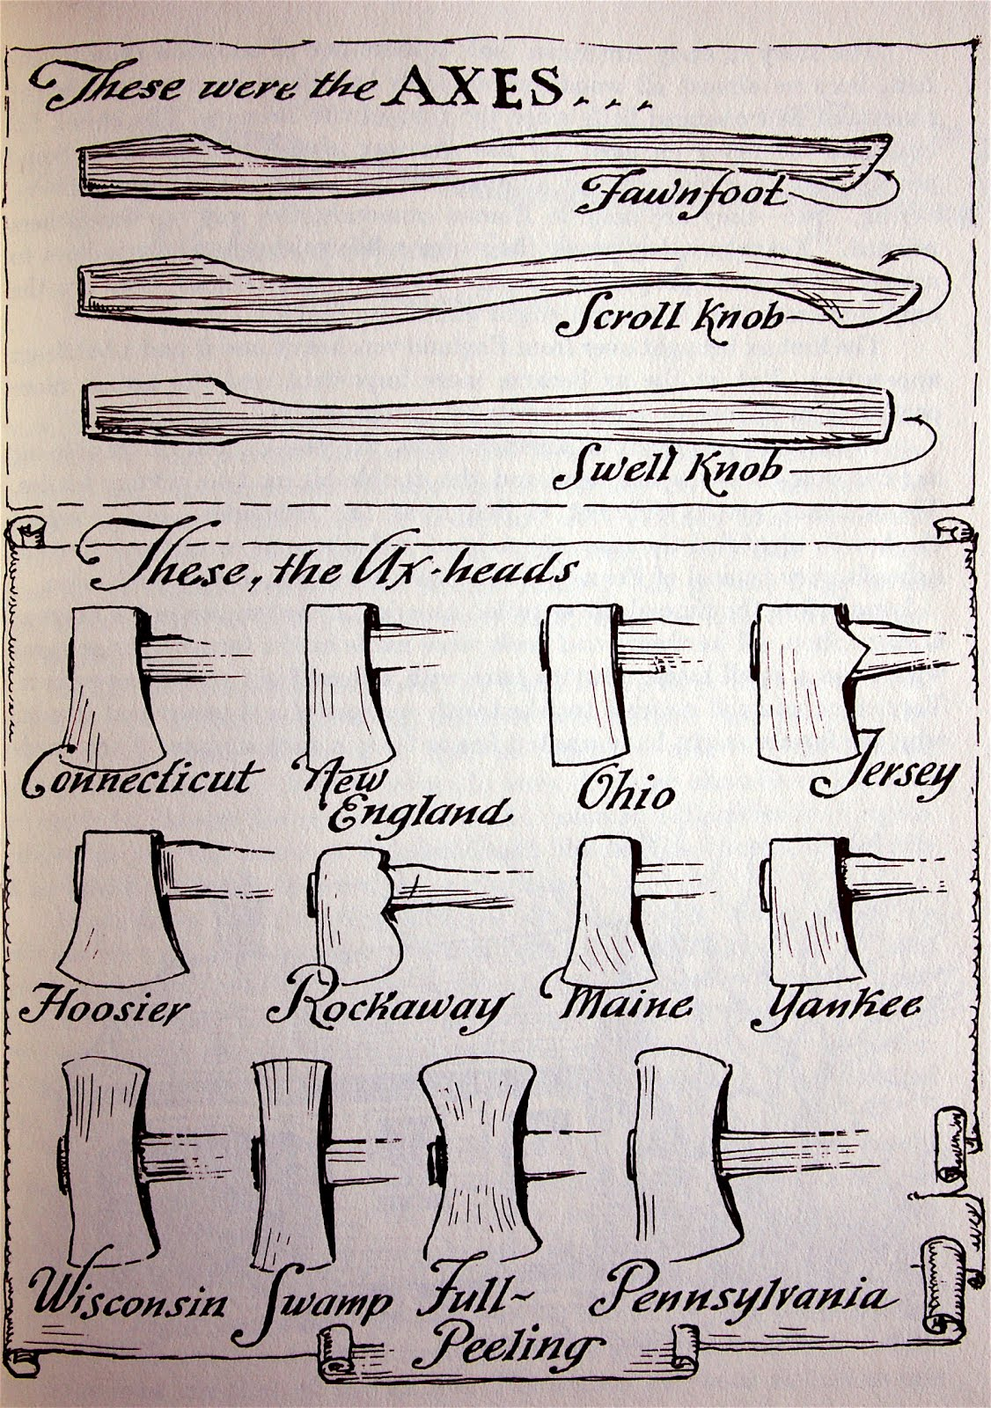
“The Ax-helve”
from New Hampshire, 1923
By Robert Frost
Learning Objective:
Demonstrate an understanding of the ideas within the poem and the techniques with which Frost presents them.
Lesson outcome: Contextual notes, a comparison of the two main characters, reflection on key ideas.

Slide 4
Useful vocabulary for this poem Copy these words down somewhere on the same page as the poem.
dialect
extended metaphor
personification
trope
allusion
characterisation
questioning
simple-minded wisdom
suspicion
judgement
knowledge
fulfilment
artisan
As we increase our understanding of the poem, see if you can spot their relevance, or try to use them in a comment to show you understand them!

Slide 5
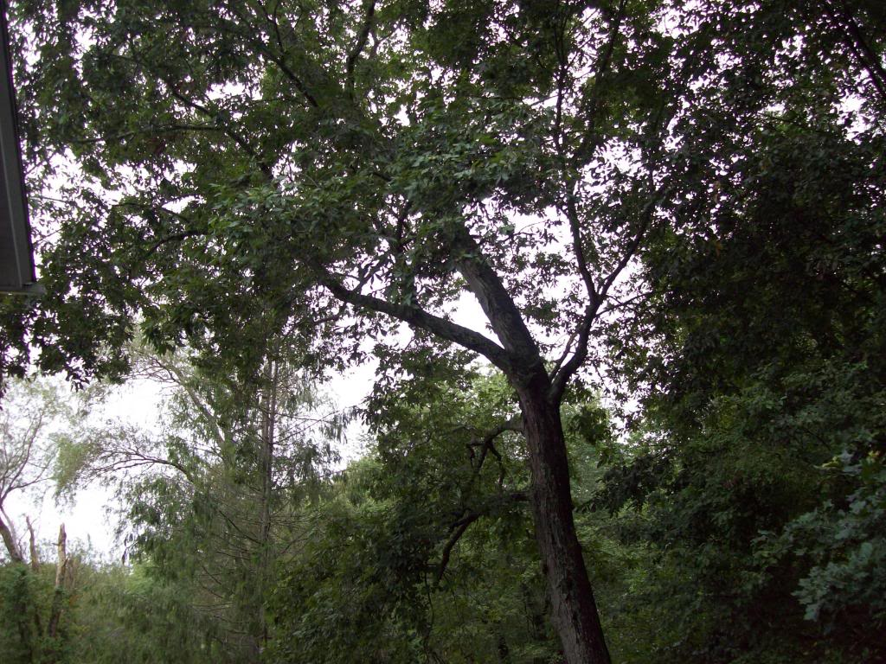
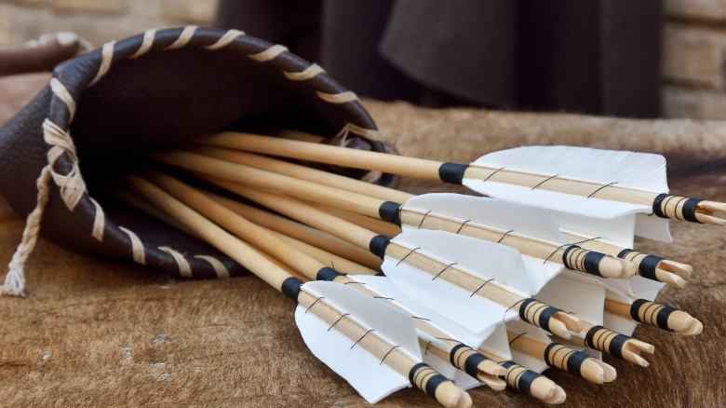
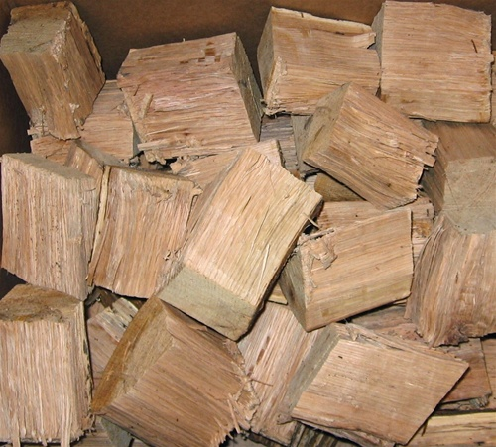
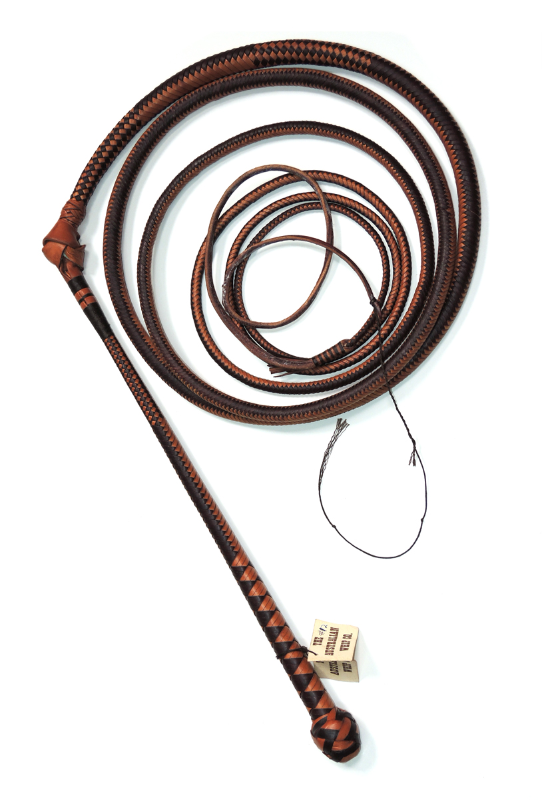
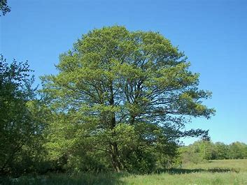
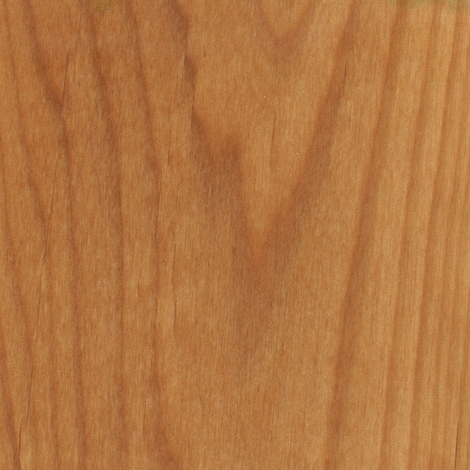
Useful vocab…
hick’ry (hickory)
quiverful
Predict: What might this poem be about?
alder
whipstock
reigning

Slide 6
Listen to the poem.
As you follow along, write down any questions that come to mind and underline or highlight any other words you don’t understand.
Baptiste

Slide 7
Listen to the poem.
This time…
Who is speaking, and what is the situation?
Challenge: Does this remind you of any other Frost poems?

Slide 8
Speaker and Situation
1st person narrator reminisces about how his lifted axe was once caught on an alder branch. He compares this incident to the moment when Baptiste came up behind him as he was working at the chopping block in his yard. Baptiste, like the alder branch, caught his axe ‘expertly on the rise.’ The narrator briefly wonders about the reason for Baptiste’s visit, considering he might want to complain about something. But Baptiste is concerned about the quality of the narrator’s ax-helve. Baptiste invites the narrator to his home where he whittles the narrator a new ax-helve. The speaker meets Baptiste’s wife who can’t “spick too much Henglish,” and while Baptiste whittles he and the speaker discuss education. The poem ends with Baptiste standing the helve upright and admiring his work.

Slide 9
Wider Context
In the early part of the 20th century, there was enormous controversy about the influx of French Canadians into New England and their refusal to assimilate into American schools and speak English.
There were questions about the isolation and independence of French Canadian immigrant communities.
French Canadians were regarded as an ethnic minority in New England.
(Faggen, 2008, p.70).

Slide 10
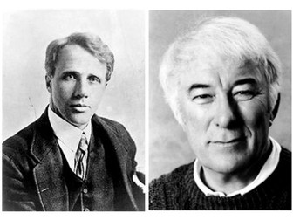
How could you describe each character?
Find and record quotes that help build the characterisation of Baptiste and the Speaker.
Explain what the quotes reveal about character.
Baptiste
Narrator

Slide 11
Nervous, suspicious
“There might be something…he might prefer to say to me disarmed”
“and yet, what was it to him?”
Strong and physically adept
“He caught my ax expertly in the rise”
Baptiste
Narrator
Reassuring – calm “Then took it from me – and I let him take it.”
Observant “Made on machine”
“It’s cost you nothing”
Generous “Come on my house and I put you one in”
Foreigner “French-Canadian”
Artisan and teacher “He showed me that the lines of a good helve were native to the grain before the knife.” “For love of it”
Works hard “his rough hand”
Values practical knowledge but conscientious “about the children he kept from school…whether the right to hold such doubts of education should depend…of those who held them.”
“Something to sell? That wasn’t how it sounded.”
Judgemental “(If overjoyed he was) at having got me.”
“To keep me from suspecting him…Needlessly soon he had his ax-helves out.”
“Used these to unscrupulously bring me”
Reflective / over-thinker
“So long as…in the measure of a neighbour.”
Unsure of his neighbour but surprised – possibly warm towards him? Lack of quoted dialogue, “and our doubts”

Slide 12
THINKING MINUTE:
Who has more power in this poem, and why?
End
1
2
3
4
5
6
7
8
9
10
11
12
13
14
15
16
17
18
19
20
21
22
23
24
25
26
27
28
29
30
31
32
33
34
35
36
37
38
39
40
41
42
43
44
45
46
47
48
49
50
51
52
53
54
55
56
57
58
59
60

Slide 13
‘You know the Canadian woodchoppers whittle their ax-handles, following the curve of the grain, and they’re strong and beautiful. Art should follow lines in nature, like the grain of an ax-handle. False art puts curves on things that haven’t any curves’
Discuss with your table:
How does the narrator’s attitude to Baptiste differ from the attitude Frost communicates in his comment about Canadian woodcutters?

Slide 14
Do Now: Write down three adjectives to describe Baptiste and three to describe the narrator.
Challenge: can you support two of your adjectives with quotes from the poem?

Slide 15
Nervous, suspicious
“There might be something…he might prefer to say to me disarmed”
“and yet, what was it to him?”
Strong and physically adept
“He caught my ax expertly in the rise”
Baptiste
Narrator
Reassuring – calm “Then took it from me – and I let him take it.”
Observant “Made on machine”
“It’s cost you nothing”
Generous “Come on my house and I put you one in”
Foreigner “French-Canadian”
Artisan and teacher “He showed me that the lines of a good helve were native to the grain before the knife.” “For love of it”
Works hard “his rough hand”
Values practical knowledge but conscientious “about the children he kept from school…whether the right to hold such doubts of education should depend…of those who held them.”
“Something to sell? That wasn’t how it sounded.”
Judgemental “(If overjoyed he was) at having got me.”
“To keep me from suspecting him…Needlessly soon” “Used these to unscrupulously bring me”
Educated Serpentine, disarmed
Reflective / over-thinker
“So long as…in the measure of a neighbour.”
Unsure of his neighbour but surprised – possibly warm towards him? Lack of quoted dialogue, “and our doubts”

Slide 16
“The Ax-helve”
from New Hampshire, 1923
By Robert Frost
Learning Objective:
Demonstrate an understanding of the ideas within the poem and the techniques with which Frost presents them.
Lesson outcome: An annotated poem, reflection on key ideas and a tick on your poem index!

Slide 17
Useful vocabulary for this poem Copy these words down somewhere on the same page as the poem.
Trope – A common or overused theme, character or plot device. E.g. horror film tropes: the vengeful spirit, white girl running upstairs, evil dolls…
dialect
extended metaphor
personification
trope
allusion
characterisation
questioning
simple-minded wisdom
suspicion
judgement
knowledge
fulfilment
artisan
Which of these words can you confidently relate to the poem so far?

Slide 18
Nervous, suspicious
“There might be something…he might prefer to say to me disarmed”
“and yet, what was it to him?”
Strong and physically adept
“He caught my ax expertly in the rise”
Baptiste
Narrator
Reassuring – calm “Then took it from me – and I let him take it.”
Observant “Made on machine”
“It’s cost you nothing”
Generous “Come on my house and I put you one in”
Foreigner “French-Canadian”
Artisan and teacher “He showed me that the lines of a good helve were native to the grain before the knife.” “For love of it”
Works hard “his rough hand”
Values practical knowledge but conscientious “about the children he kept from school…whether the right to hold such doubts of education should depend…of those who held them.”
“Something to sell? That wasn’t how it sounded.”
Judgemental “(If overjoyed he was) at having got me.”
“To keep me from suspecting him…Needlessly soon” “Used these to unscrupulously bring me”
Educated Serpentine, disarmed
Reflective / over-thinker
“So long as…in the measure of a neighbour.”
Unsure of his neighbour but surprised – possibly warm towards him? Lack of quoted dialogue, “and our doubts”

Slide 19
Trope of Simple-Minded Wisdom
A "simple" character (particularly a servant or rural character) displays uncommon wisdom — usually much to the surprise of an arrogant main character.
“Do you know, what we talked about was knowledge?”
Baptiste in ‘The Ax-Helve’ has limited English, shown through _______________ In the pastoral tradition, those regarded as low, untutored or rustic may be represented as insightful.
Baptiste
“He showed me that the lines of a good helve were native to the grain before the knife.”

Slide 20
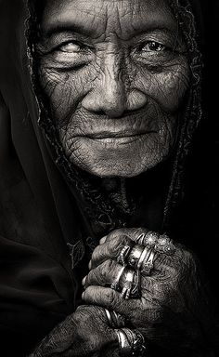
Trope of Simple-Minded Wisdom
A "simple" character (particularly a servant or rural character) displays uncommon wisdom — usually much to the surprise of an arrogant main character.
“Mrs Baptiste came in and rocked a chair that had as many motions as the world”
Baptiste’s wife too, presented by Frost as slightly witch-like, adds to the depiction of this couple as holding wisdom that comes from the “simple” or unexpected.
“…as if she understood what passed between us, she was only feigning.”

Slide 21
Close analysis of the poem – annotate as we discuss
The Ax-Helve
I've known ere now an interfering branch Of alder catch my lifted ax behind me. But that was in the woods, to hold my hand From striking at another alder's roots, And that was, as I say, an alder branch. This was a man, Baptiste, who stole one day Behind me on the snow in my own yard Where I was working at the chopping block, And cutting nothing not cut down already. He caught my ax expertly on the rise, When all my strength put forth was in his favor, Held it a moment where it was, to calm me, Then took it from me – and I let him take it

Slide 22
Close analysis of the poem – annotate as we discuss
I didn't know him well enough to know What it was all about. There might be something He had in mind to say to a bad neighbor He might prefer to say to him disarmed.
But all he had to tell me in French-English Was what he thought of – not me, but my ax, Me only as I took my axe to heart. It was the bad ax-helve someone had sold me - 'Made on machine,' he said, ploughing the grain With a thick thumbnail to show how it ran Across the handle's long, drawn serpentine, Like the two strokes across a dollar sign. 'You give her 'one good crack, she's snap raght off. Den where's your hax-ead flying t'rough de hair?'

Slide 23
Close analysis of the poem – annotate as we discuss
Admitted; and yet, what was that to him? 'Come on my house and I put you one in What's las' awhile - good hick'ry what's grow crooked,
De second growt' I cut myself – tough, tough!' Something to sell? That wasn't how it sounded. 'Den when you say you come? It's cost you nothing. To-naght?' As well to-night as any night.

Slide 24
Close analysis of the poem – annotate as we discuss
Beyond an over-warmth of kitchen stove My welcome differed from no other welcome. Baptiste knew best why I was where I was. So long as he would leave enough unsaid, I shouldn't mind his being overjoyed (If overjoyed he was) at having got me Where I must judge if what he knew about an ax That not everybody else knew was to count For nothing in the measure of a neighbour. Hard if, though cast away for life with Yankees, A Frenchman couldn't get his human rating!

Slide 25
Close analysis of the poem – annotate as we discuss
Mrs. Baptiste came in and rocked a chair That had as many motions as the world: One back and forward, in and out of shadow, That got her nowhere; one more gradual, Sideways, that would have run her on the stove In time, had she not realized her danger And caught herself up bodily, chair and all, And set herself back where she, started from. 'She ain't spick too much Henglish – dat's too bad.' I was afraid, in brightening first on me, Then on Baptiste, as if she understood
What passed between us, she was only feigning. Baptiste was anxious for her; but no more Than for himself, so placed he couldn't hope To keep his bargain of the morning with me In time to keep me from suspecting him Of really never having meant to keep it.

Slide 26
Close analysis of the poem – annotate as we discuss
Needlessly soon he had his ax-helves out, A quiverful to choose from, since he wished me To have the best he had, or had to spare – Not for me to ask which, when what he took Had beauties he had to point me out at length To insure their not being wasted on me. He liked to have it slender as a whipstock, Free from the least knot, equal to the strain Of bending like a sword across the knee. He showed me that the lines of a good helve Were native to the grain before the knife Expressed them, and its curves were no false curves Put on it from without. And there its strength lay For the hard work. He chafed its long white body From end to end with his rough hand shut round it. He tried it at the eye-hold in the ax-head. 'Hahn, hahn,' he mused, 'don't need much taking down.' Baptiste knew how to make a short job long For love of it, and yet not waste time either.

Slide 27
Close analysis of the poem – annotate as we discuss
Do you know, what we talked about was knowledge? Baptiste on his defence about the children He kept from school, or did his best to keep –
Whatever school and children and our doubts
Of laid-on education had to do With the curves of his ax-helves and his having Used these unscrupulously to bring me To see for once the inside of his house. Was I desired in friendship, partly as someone To leave it to, whether the right to hold Such doubts of education should depend Upon the education of those who held them?

Slide 28
Close analysis of the poem – annotate as we discuss
But now he brushed the shavings from his knee And stood the ax there on its horse's hoof,
Erect, but not without its waves, as when The snake stood up for evil in the Garden – Top-heavy with a heaviness his short, Thick hand made light of, steel-blue chin drawn down And in a little – a French touch in that. Baptiste drew back and squinted at it, pleased: ‘See how she's cock her head!’

Slide 29
What do snakes symbolise?
In the bible, the devil (originally a trickster spirit) inhabited a snake to tempt Eve into eating fruit forbidden by God.
By eating the fruit she gained knowledge and her and Adam were cast out of Eden. They gained - the knowledge of good and evil, and free will.
The woman said to the serpent, “We may eat fruit from the trees in the garden, but God did say, ‘You must not eat fruit from the tree that is in the middle of the garden, and you must not touch it, or you will die.’”
“You will not certainly die,” the serpent said to the woman. “For God knows that when you eat from it your eyes will be opened, and you will be like God, knowing good and evil.”

Slide 30
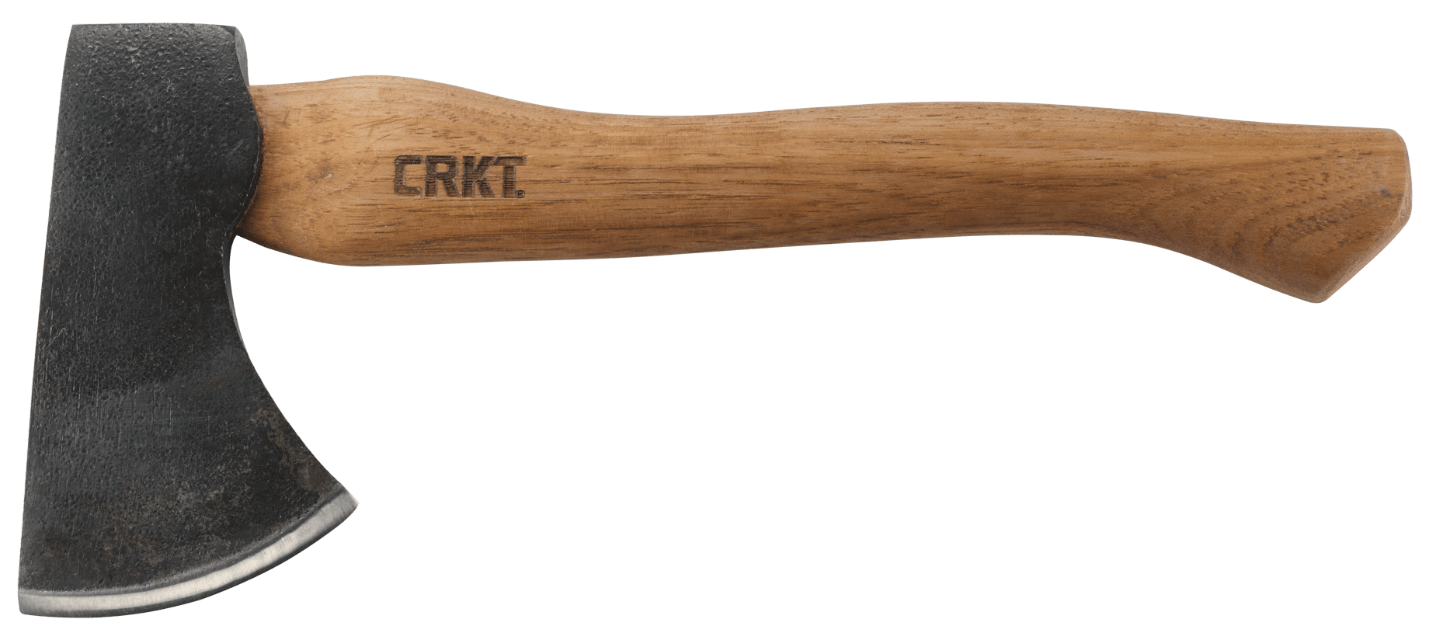
How is the image of the ax-helve a symbol for:
Art?
Relationships and communication?
Education?
Purpose and fulfilment through labour?

Slide 31
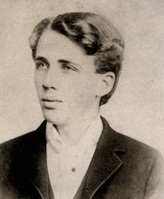
Linking to previous learning
What other poems by Robert Frost could this poem link to, and why?

Slide 32
Contextual/Critical Information (K)
Recap: What contextual information about Robert Frost might be relevant to this poem?

Slide 33
What contextual information about Robert Frost might be relevant to this poem?
Classical education – familiar with myths and legends and the bible
French-Canadian immigration to New England
Desire to replicate the truth of life through art – which is hard work but worthwhile
Use of conversational, colloquial style – accessible, authentic
Tendency to use familiar experience as metaphor for “profoundest thinking”
LINK TO:
Mending Wall, Mowing, Hired Man, Black Cottage
Pastoral mode – depicts the life of rural figures

Slide 34
Demonstrate your learning!
How does Frost develop an idea in this poem?
Frost uses the ax-helve as a symbol for ________________.“__________________”. The technique of _____________ in this quotation encourages the reader to recognise…
C
+ a context comment! Genre, typical conventions, Frost’s life experience…

Slide 35
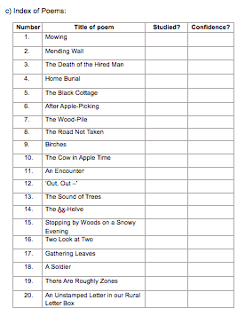
“The Ax-Helve” – studied!
Give it a tick, a date and a confidence rating out of 10.

